Slide 1


Two-scale finite element simulations for UT inspection of micro-structured materials in CIVA
Nuclear applications in collaboration with
Edouard Demaldent, Nicolas Leymarie, Vincent Dorval, Alexandre Imperiale, Thibaud Fortuna
Université Paris-Saclay, CEA, List, F-91120, Palaiseau, France
Notes:
This work from CEA List is focused on the finite element method for ultrasonic testing in the CIVA software,
And I have to mention that most of these works are motivated by nuclear applications with strong support from EDF

Slide 2
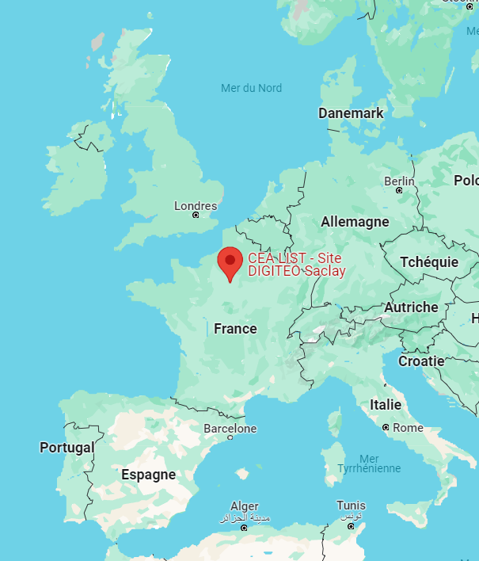
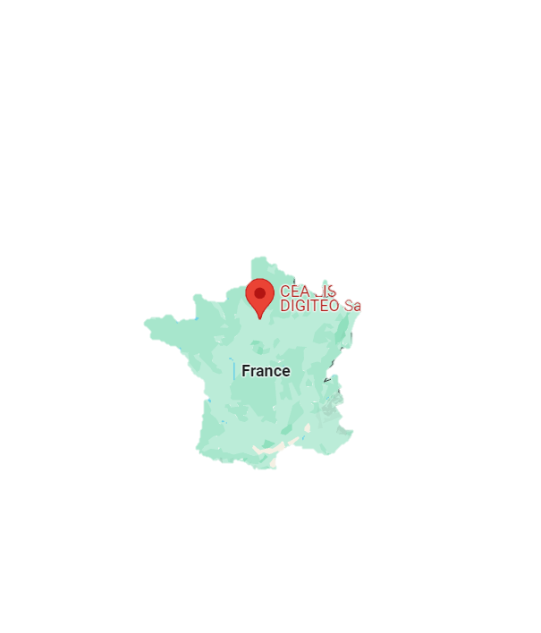
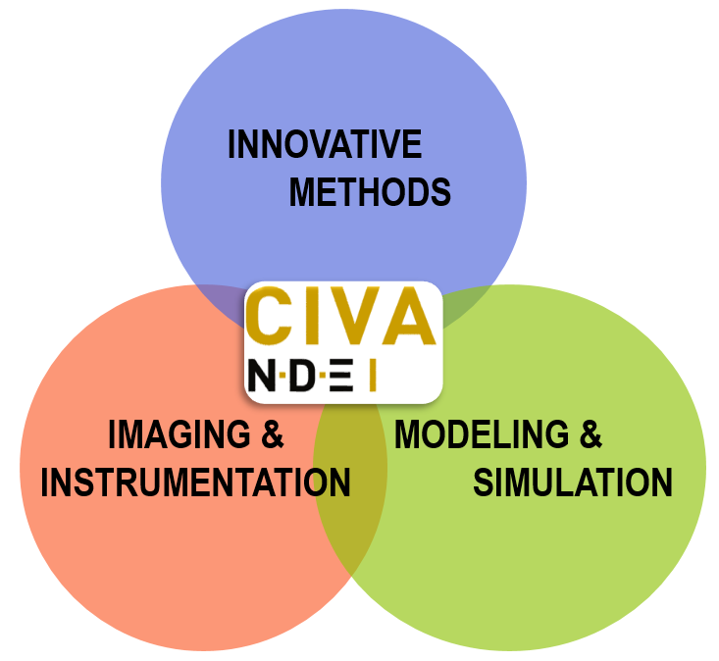



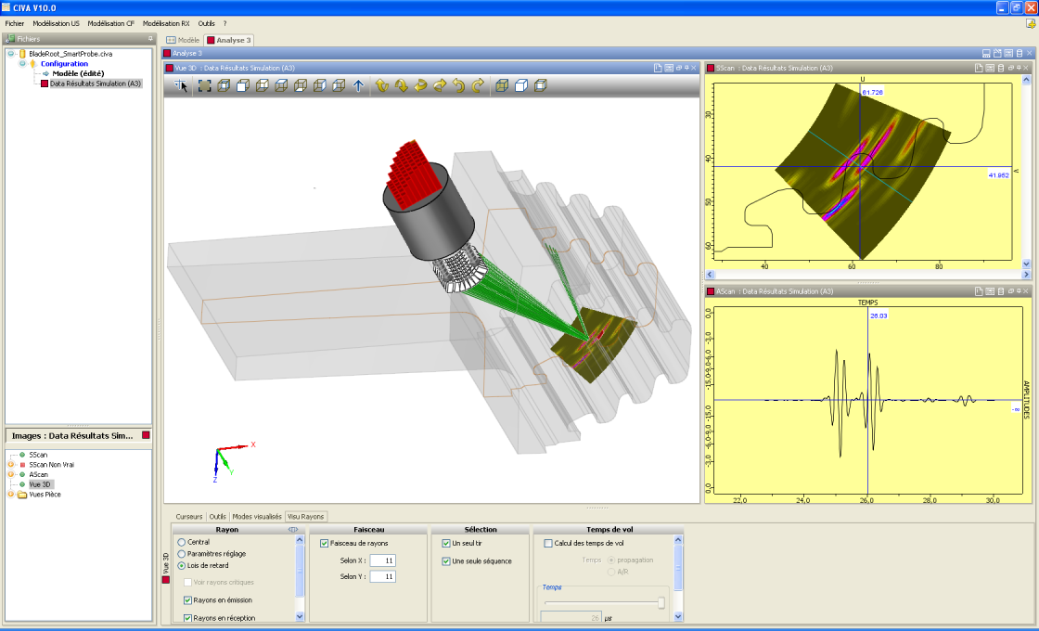
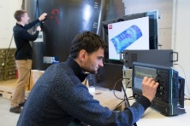



Non destructive evaluation at CEA List
01
02
03
NDE team at CEA List : ~ 110 staff members
including 25 PhD & post-doc
Large industrial partnership in main sectors concerned by NDE
Strong academic collaborations : through CIVA network, National, European and International projects, …
Three-fold R&D activity
Experimental & numerical platforms
Addressing the main NDE modalities:
Ultrasound, Electromag. (ET,…), X-Ray & CT, Guided Waves, Thermography (IR), …
Notes:
We are more than 100 staff members working on NDE at CEA LIST, in France, near Paris
With both academic and industrial strong partnerships in France and abroad.
With both instrumentation and simulation skills to promote innovative inspection solutions or to demonstrate the performance of existing ones
We share these skills with our partners through experimental collaborative platforms in our lab that is located near Paris in France

Slide 3
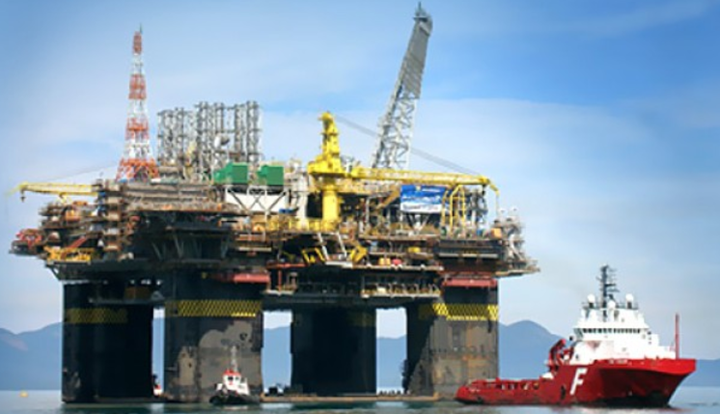
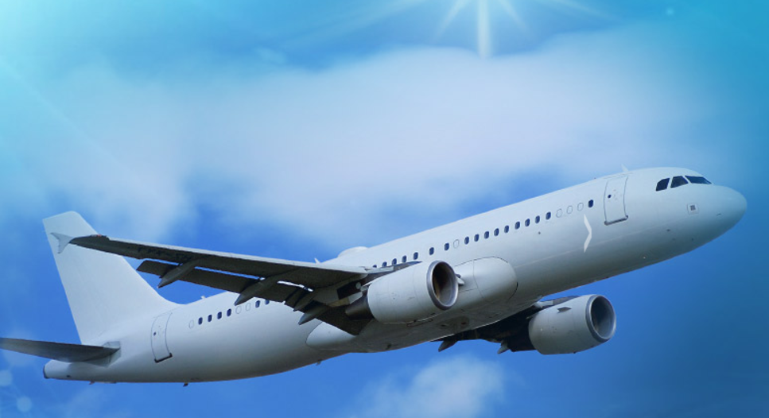


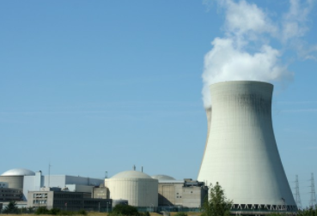

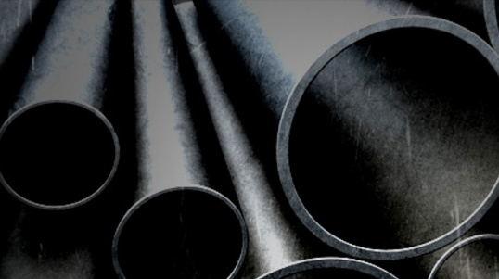





NDE simulation software platform
WORLD LEADER
IN NDT SIMULATION
A multi-technique software platform
2020
Developed by CEA-List
Distributed by EXTENDE
CIVA USERS: More than 300 companies
and Labs in 40 countries
2020
2021
2022
NDE Simulation and analysis
  Integrate basic research achieved at CEA List
  Release annual versions containing new tools
  Collaborative plat-form, Plug-In technology
Notes:
We are developing the CIVA simulation and analysis software platform, which is distributed by extende.
We gradually integrate our modelling research work in the main NDT fields.
And this presentation concerns the ultrasonic testing module

Slide 4
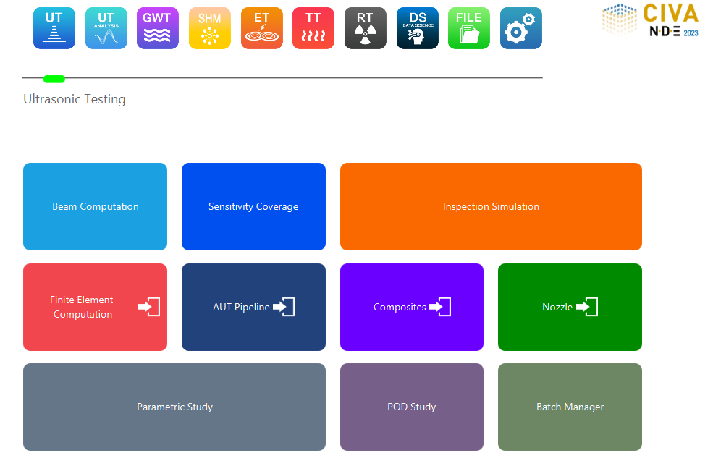


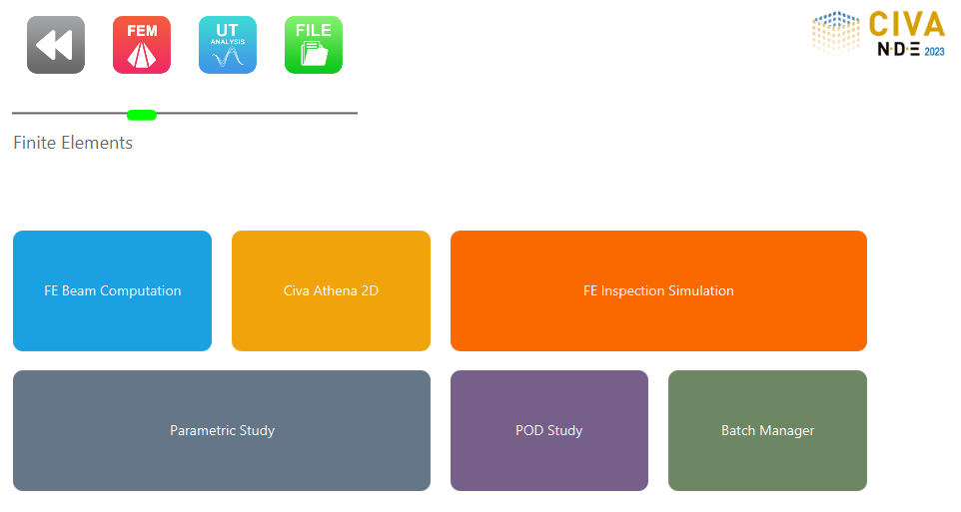

Incoming FEM module in CIVA
2025
Notes:
And more specifically it concerns the developments of new FE module in the CIVA platform for ultrasonic testing simulation

Slide 5
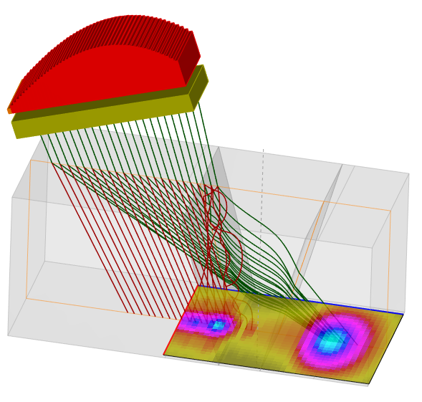
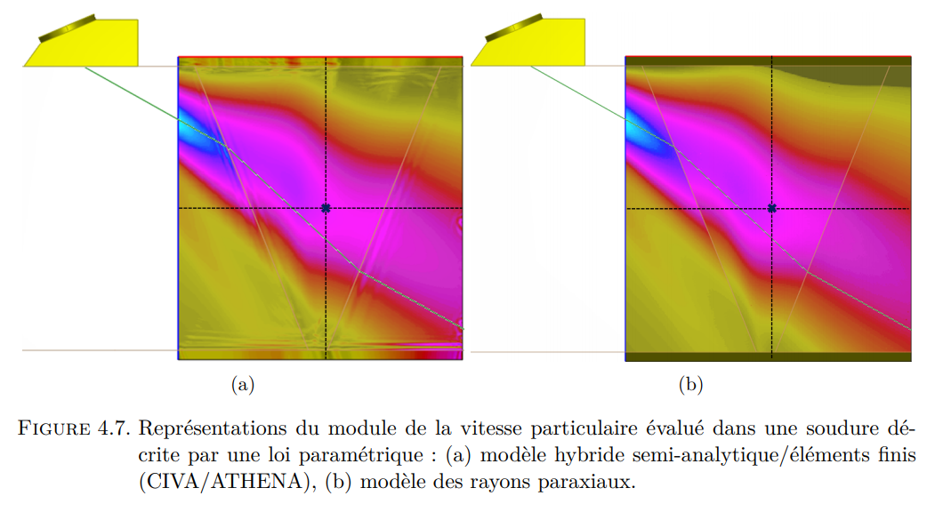
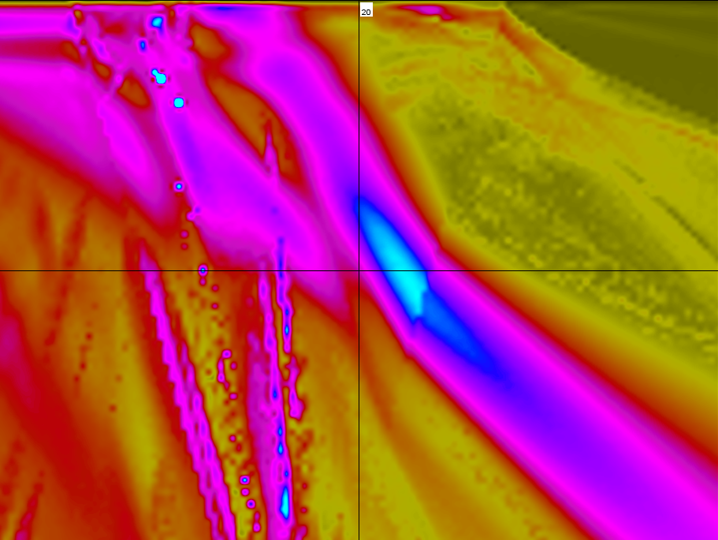

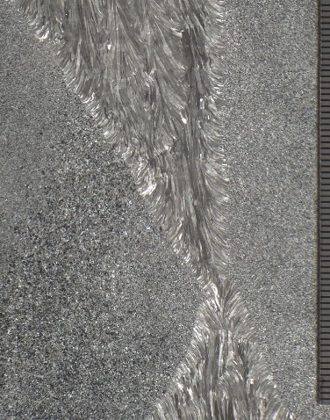


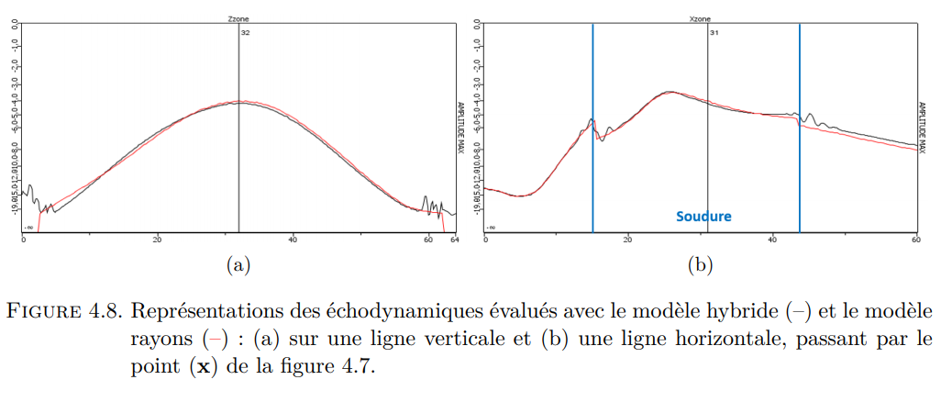
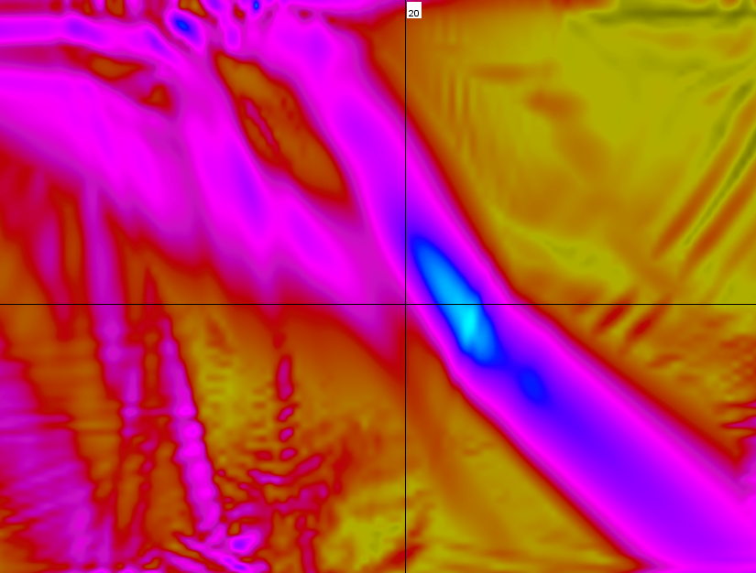

Motivations
  Validate/complete standard semi analytical models (ray tracing, KGTD...) in critical cases
  Gradual introduction of transient FEM and hybrid tools in CIVA UT
  Compatible with a standard PC: NDT studies in 2D, a few shots or scans in 3D
The ultrasonic testing of austenitic welds
Complex structured materials
Ray tracing
Finite Elements
Ray tracing
ILLUSTRATION UT SA
Finite Elements
Notes:
The semi-analytical simulation tools within CIVA are operational for the majority of practical industrial applications, but their validation remains a critical issue in certain complex configurations.
Because it is difficult to assess their accuracy beyond their range of theoretical validity.
We illustrate here the simulation of a weld inspection, where the validity of the ray tracing depends on the both the weld material description, the beam trajectory through the weld, and the location of the estimate of the field.

Slide 6
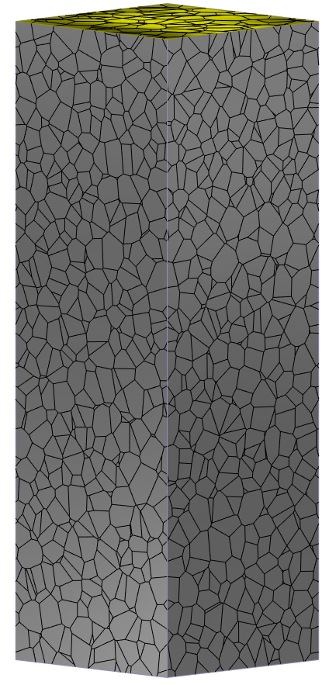
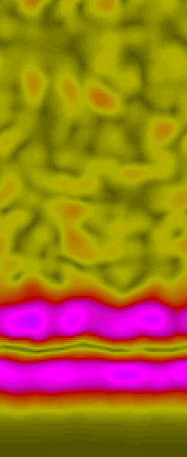
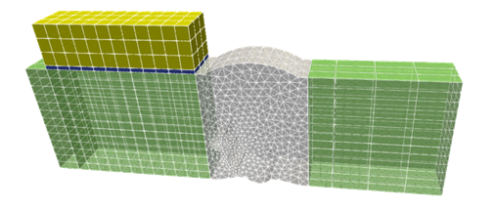
Motivations
  Validate/complete standard semi analytical models (ray tracing, KGTD...) in critical cases
  Gradual introduction of transient FEM and hybrid tools in CIVA UT
  Compatible with a standard PC: NDT studies in 2D, a few shots or scans in 3D
  This presentation: Two-scale FEM simulations for UT of micro-structured materials
2025
2027
anisotropic
isotropic
  Part & Defect
  Microstructure
Macro(Wave)-scale
Micro(Grain)-scale
Notes:
In this presentation I introduce the two-scale FEMs that we are developing
At the wavelength scale to simulate inspection with defects on the one hand,
and at the grain scale to define the effective properties of the materials that are used at the wave scale
I will focus on the specific case of weld inspection and one difficulty concerns the anisotropic and viscoelastic description of the weld medium.

Slide 7
Macro (Wave) – Scale Simulation
Weld Inspection
Notes:
Je commence par introduire la simulation à l’échelle de la structure

Slide 8
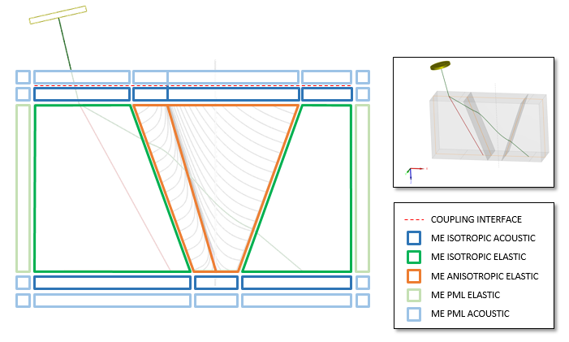
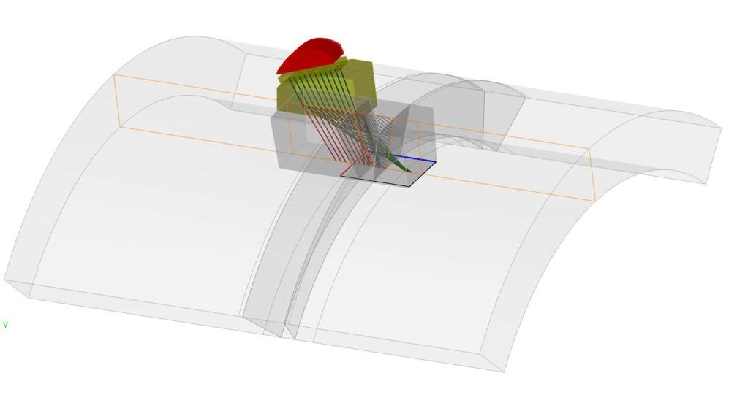
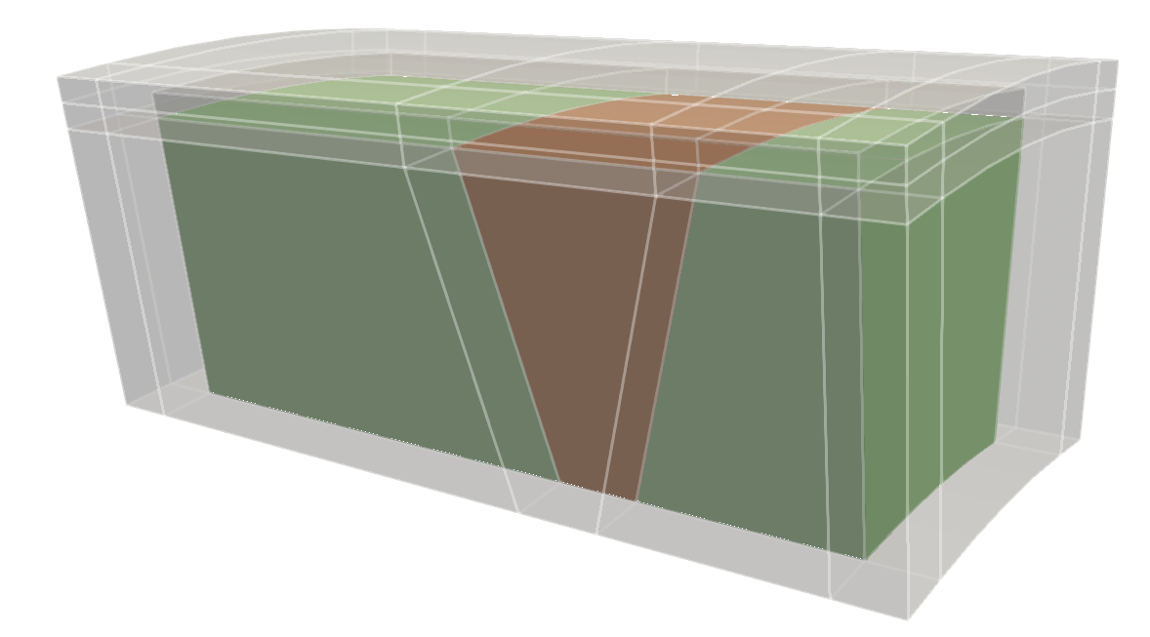
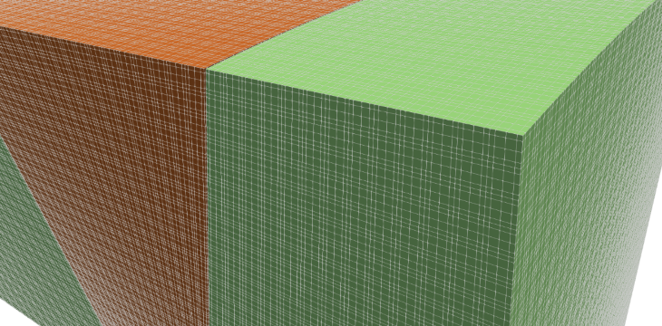

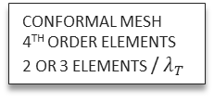
Wave-Scale, high-order FEM model
  Spectral-like transient FEM → High-order hexahedrons, time-explicit, factorized stiffness mat-vect, low memory footprint…
  Mortar DDM for stability and ease of coupling of propagators → Fluid, solid, visco, pml, etc...
  Hyper-mesh description of the inspection scene → Automated mesh refinement (w.r.t. λ) & hybrid settings (coupling zone)
Ray tracing pretreatment to adjust the region of interest
Domain Decomposition Method
3D sub-domains
Final mesh
CONFORMAL MESH
4TH ORDER ELEMENTS
2 OR 3 ELEMENTS / $λ_{T}$
Notes:
For wave-scale simulation, our solution is based on a spectral transient FEM, that is a particular high-order FEM with a small memory footprint and low computation time,
We also rely on a domain decomposition strategy, as illustrated here to simulate the inspection of a weld.
Each sub-domain is associated with a unique propagator: fluid or solid, if solid then isotropic or anisotropic, possibly with a continuously varying orientation map, with or without damping, and absorbing or not, such as Perfectly Matched Layers surrounding the FEM box.
Two adjacent subdomains are connected by a mortar element and we can, for example, define an effective transmission condition between two subdomains.
An important point is that we can use the fast ray tracing algorithm of CIVA to predict the dimensions of the finite element domain as well as the delay laws of the probe.

Slide 9
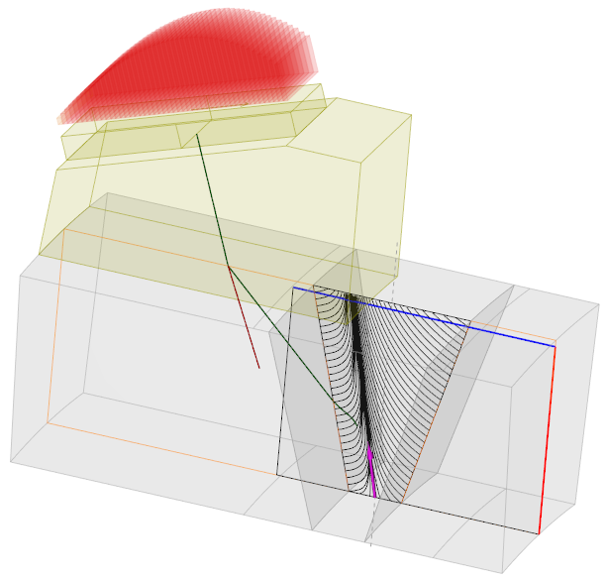
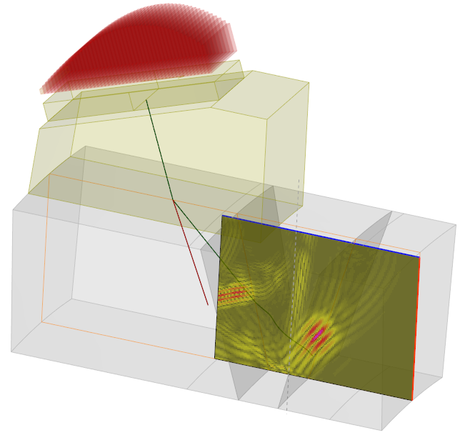
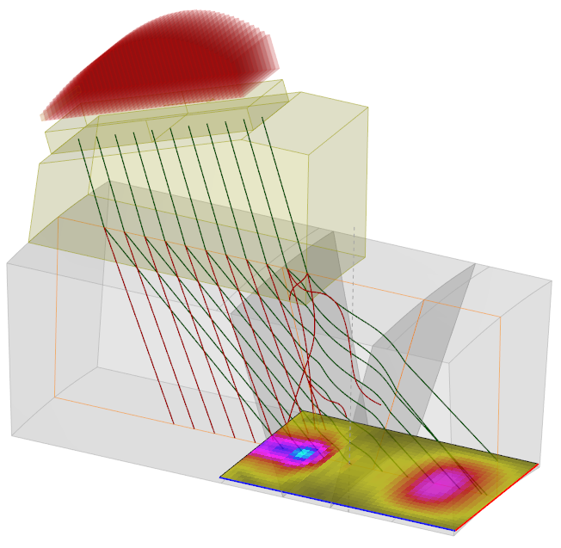

Wave-Scale, high-order FEM model
  Ray-based calculation of the source field in the coupling above the specimen
  Automated build-up of the FEM
  Field extraction in a 2D or 3D region of interest
20 µs | SFEM 3D | SFEM 2D | Ray 3D
1 MHz | 20 min < 1GB | <30 sec | L ~ 2 min T ~ 10 min …
2 MHz | 200 min < 7 GB | <40 sec
Region of interest
for field extraction
Intel(R) Core(TM) i9-9880H CPU @ 2.30GHz
30 mm
75 mm
30 mm
Ogilvy description
& constant attenuation
Superposed SFEM results
with ray tracing analysis
SFEM calculation domain
Notes:
Also, a ray-based calculation of the source field is performed in the coupling domain above the sample
CIVA provides an automated construction of the FEM
Here we show an illustration of a V-shaped weld inspected with a linear probe and a L45 point focusing law on the back wall.
wW simulate in 3D the propagation of the ultrasonic beam during 20 µs in viscoelastic and anisotropic materials.
It tooks 20 minutes for an inspection at a central frequency of 1 MHz and less than 1GB of RAM, and 200 minutes at 2 MHz with less than 7 GB of RAM on a good laptop.
These are very good results for 3D simulation

Slide 10

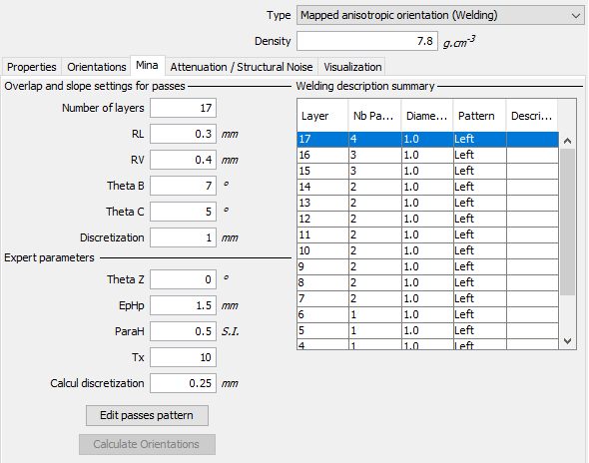
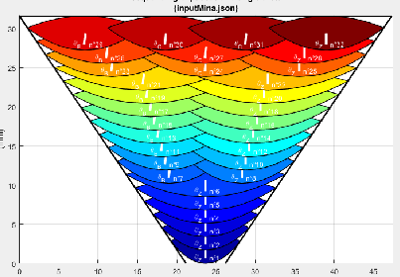
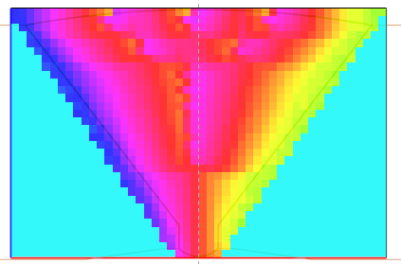
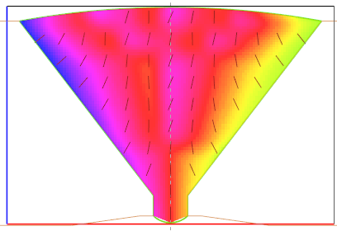
Custom GUI tools – Weld description
2025
from grain scale simulation
  Viscoelastic quasi-hexagonal effective material
  Anisotropy direction ~ grain elong. axis
  2D grain orientation variation in multi-pass welds
  Scalar angle grid data [MINA]
  Smooth interpolation [CIVA]
INPUT
  Smoothly inhomogeneous material is compatible with the fast semi-analytical CIVA approach and promotes high-performance FEM
MINA
CIVA
Notes:
We also introduced a GUI of the MINA software to predict the main elongation axis of the grain in the weld depending on the welding process descriptions, for example with the number of layers and the number of passes per layer.

Slide 11

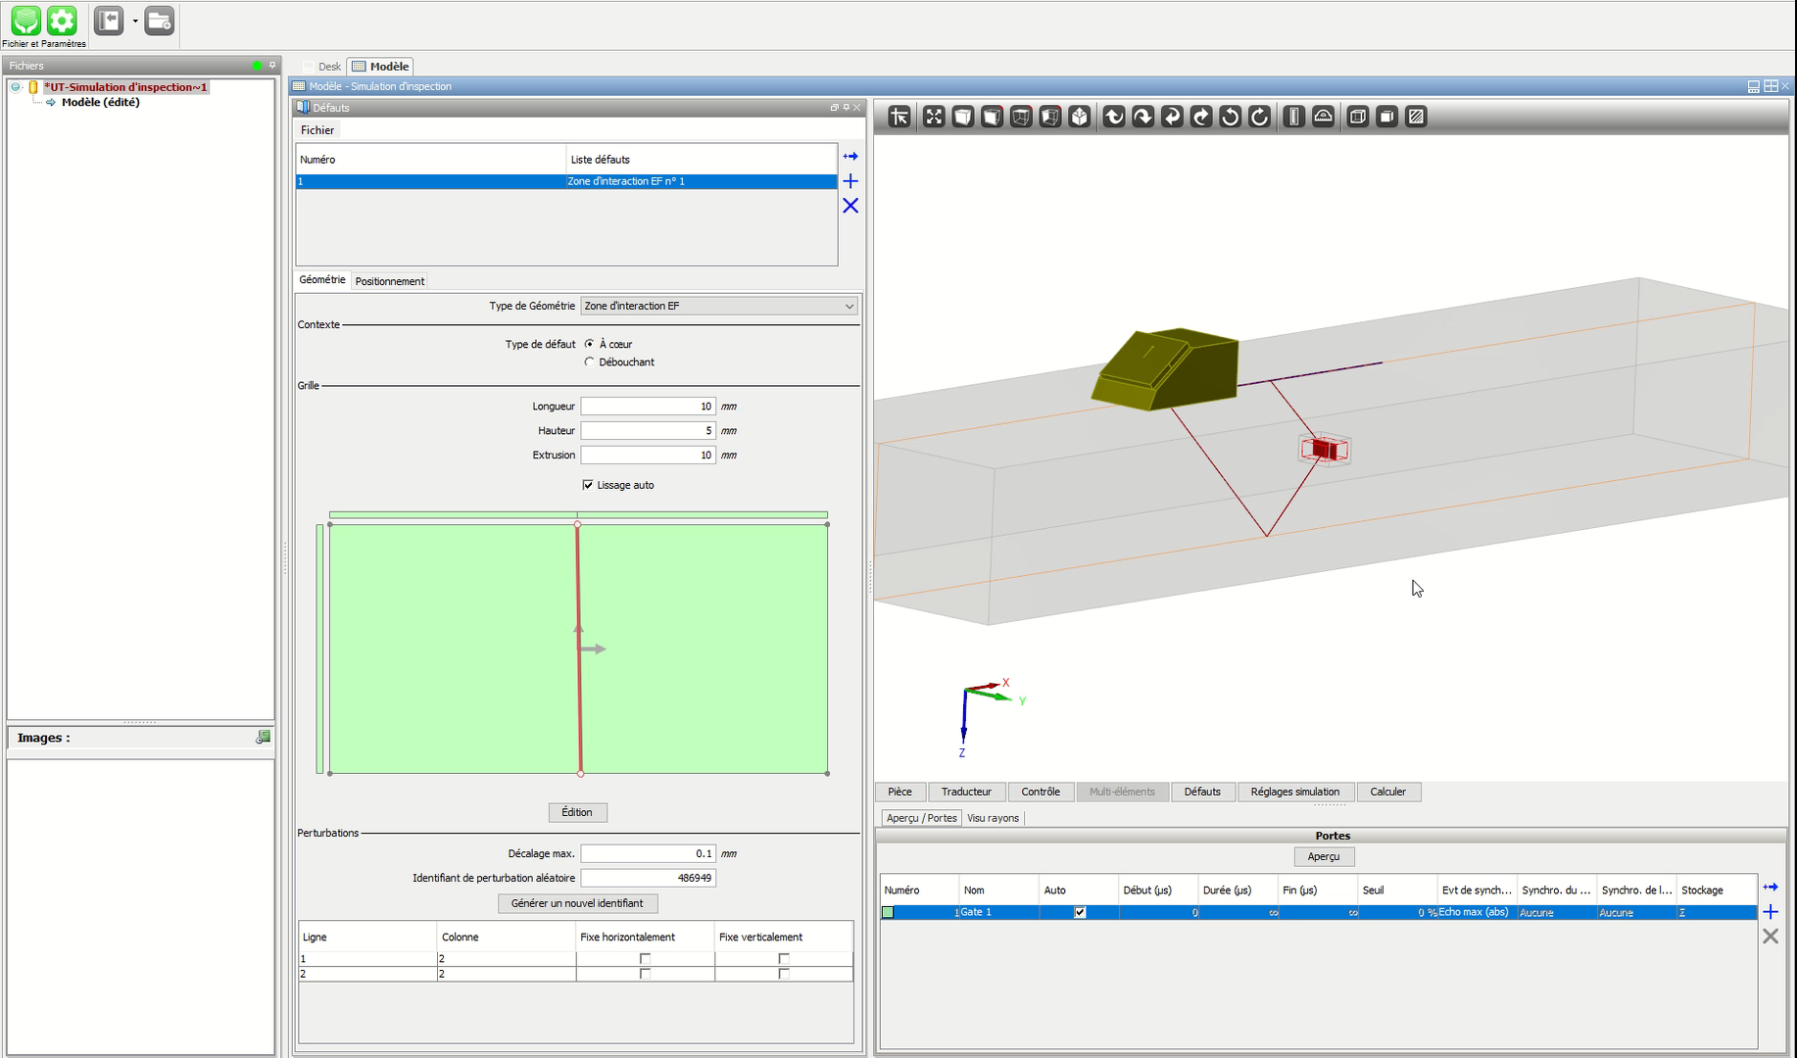
Custom GUI tools – Flaw description
  Introduce new cells into the FEM box
  Declare certain edges of the grid as cracks
  Move nodes to get closer to the desired shape
  Alert the user to additional cpu costs
  Perform slight random geometric variations
  …
  2D geometry is extruded over a limited distance to simulate a 3D defect
  Automated mesh refinement (w.r.t. λ) & hybrid settings (coupling zone)
Notes:
We also develop custom graphical user interface tools for configuring the FE mesh with complex shaped flaw descriptions, as shown here:
we introduce new cells into the FEM box, we move nodes to get closer to the flaw shape, we declare certain edges of the grid to be cracks, the color palette warns the user of extra cpu costs, we can also make slight random geometric variations to perform a sensitivity study, and so on and so forth

Slide 12
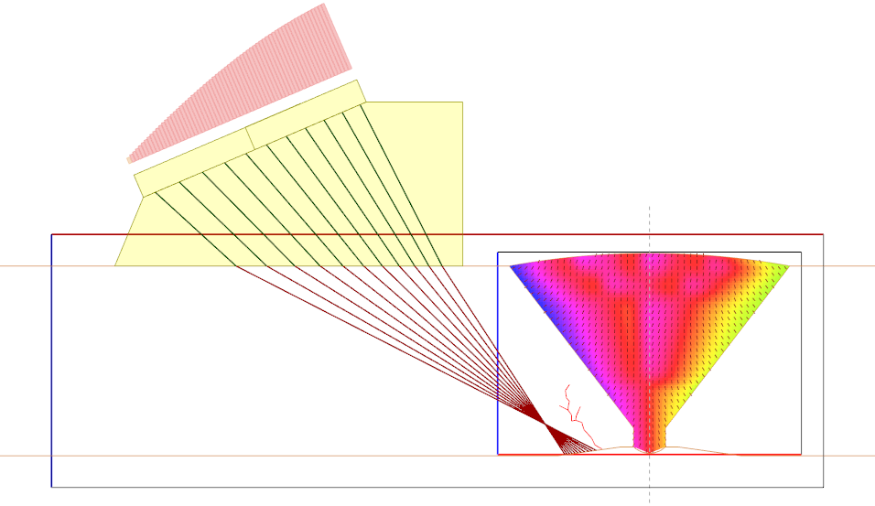
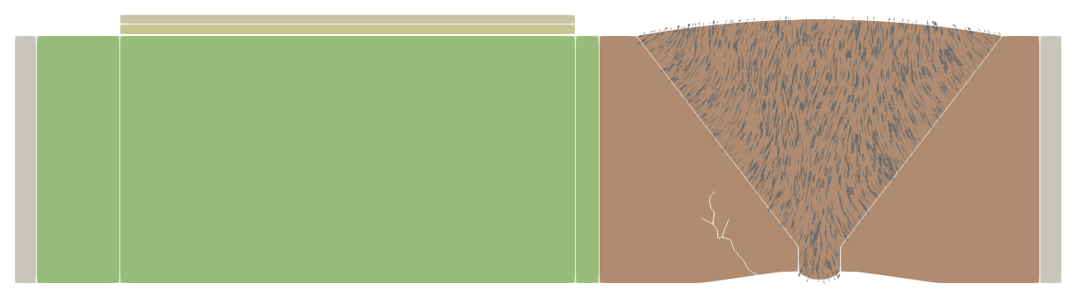
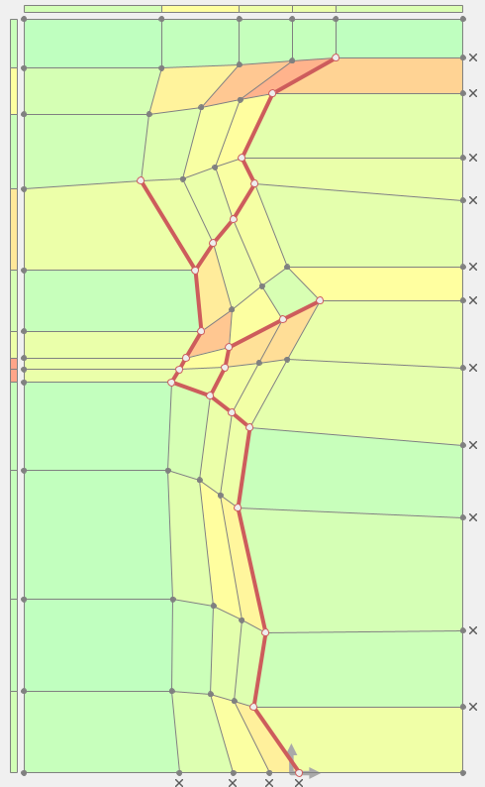
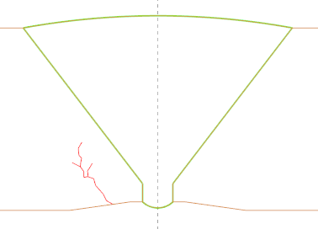
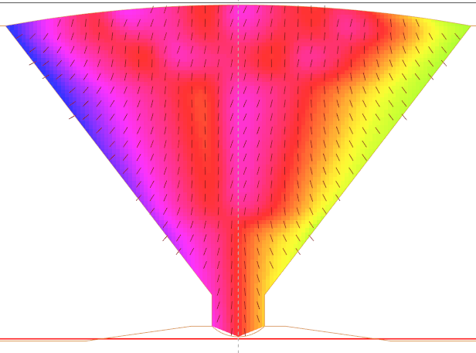
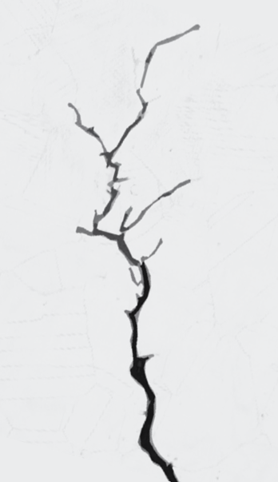
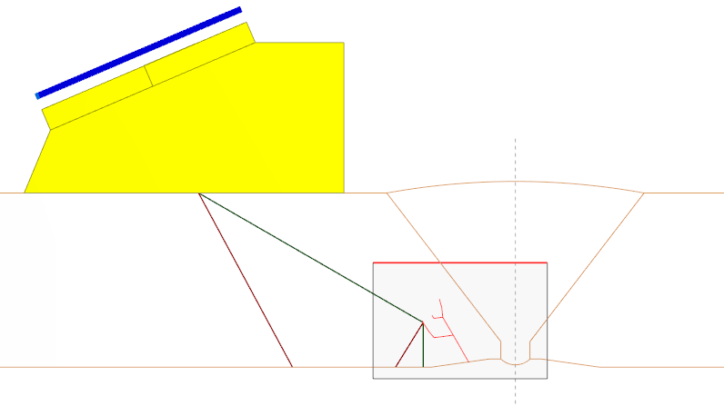
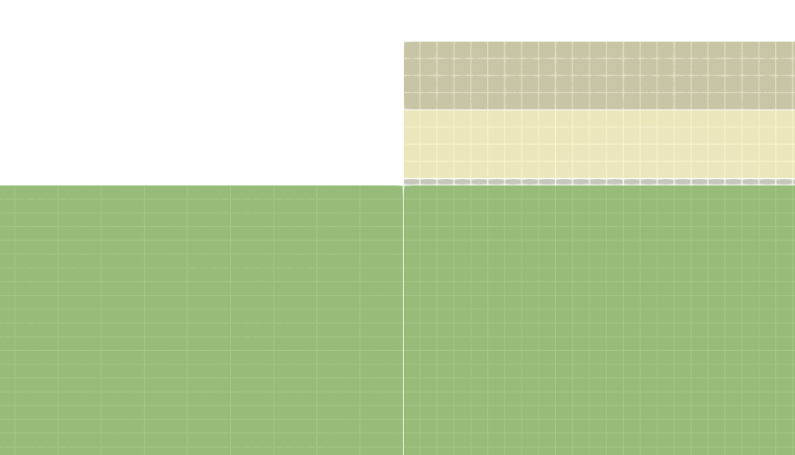
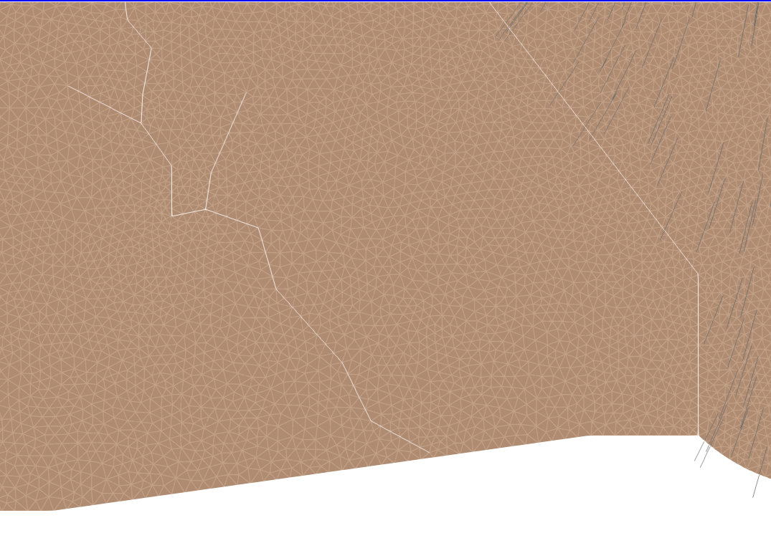
Numerical simulation of TFM imaging
Application case
PAUT L60 wedge probe @ 2.25 MHz
Linear, 64 elements, pitch 0.6 mm
FMC acquisition
64 transmit shots (1 FE simulation/shot)
TFM imaging
Homogeneous assumption for imaging
Coupling interface using ray source fields
ROI delimiting FE domain
Absorbing layer
Absorbing layer
Absorbing layer
Unstructured tri-mesh
ETC
Wedge layer
  Stress Corrosion Cracking (SCC)
  MINA weld description
  CIVA configuration
Structured quad mesh
Notes:
Now we simulate a TFM imaging with a crack and a weld, for a 64 elements linear wedge probe
The FEM box is shown on the right with the TFM reconstruction area, and this is the details of the automated meshing process

Slide 13
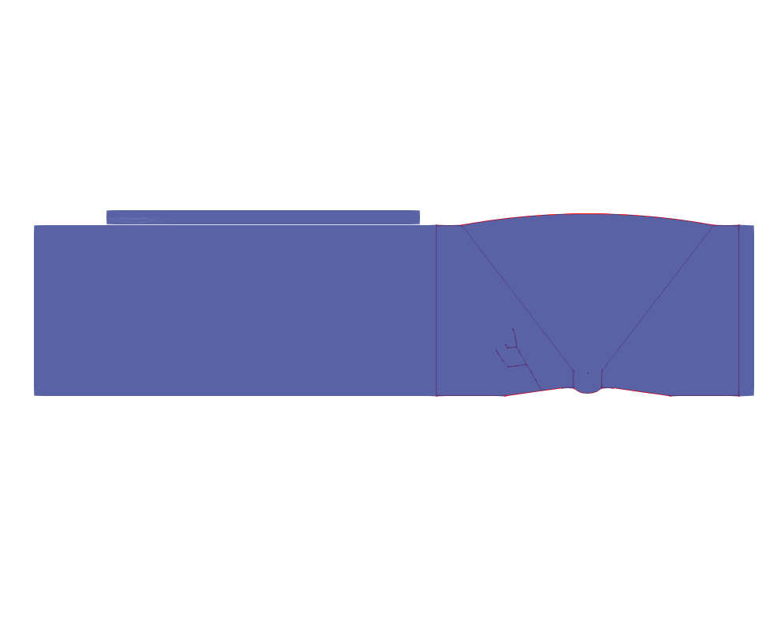


Numerical simulation of TFM imaging
Application case
PAUT L60 wedge probe @ 2.25 MHz
Linear, 64 elements, pitch 0.6 mm
FMC acquisition
64 transmit shots (1 FE simulation/shot)
TFM imaging
Homogeneous assumption for imaging
shot #1
shot #32
shot #64
Notes:
These are simulated fields for a few of the 64 FE simulations for each new TFM reconstruction.

Slide 14
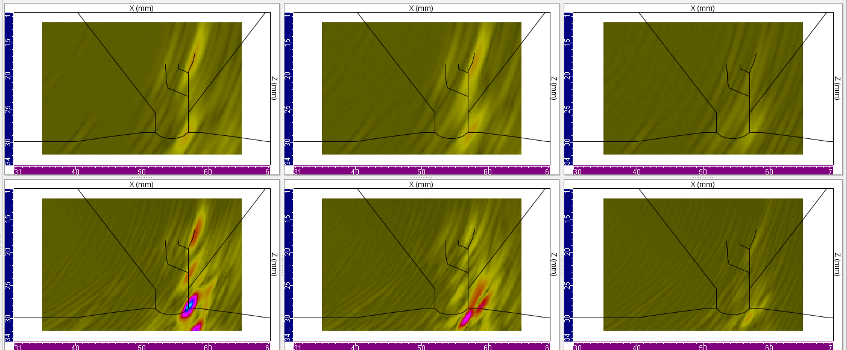
Numerical simulation of TFM imaging
Application case
PAUT L60 wedge probe @ 2.25 MHz
Linear, 64 elements, pitch 0.6 mm
FMC acquisition
64 transmit shots (1 FE simulation/shot)
TFM imaging
Homogeneous assumption for imaging
Homogeneous
& Isotropic
(82 s/shot*)
Heterogeneous
& Anisotropic…
(175 s/shot*)
…& damping
(204 s/shot*)
Longi
-13 dB
-13 dB
-19 dB
Shear
0 dB
-4 dB
-13 dB
Influence of welding characteristics on performance losses
(*) calculation performed on [Dual CPU] Intel Xeon Platinum 8276L 56 cores @ 2.20GHz – 512Go
Further details in [Leymarie et al., NDE in Nuclear 2023]
Notes:
We now present TFM imaging obtained with complex cracking at the root of the weld.
We use simulation to assess the influence of material characteristics on performance losses: with non realistic homogeneous isotropic properties on the left, with smoothly inhomogeneous anisotropic MINA description in the middle, PLUS viscoelasticity on the right.
As you can see, the material assumption has a significant impact on the TFM imaging reconstruction,
And that motivates to perform accurate prediction of the material properties that is used in the wave-scale simulation, particularly for shear wave inspection.

Slide 15
Micro (Grain) – Scale Simulation
Isotropic / Anisotropic materials
Notes:
So i now focus on this task with grain scale simulation

Slide 16
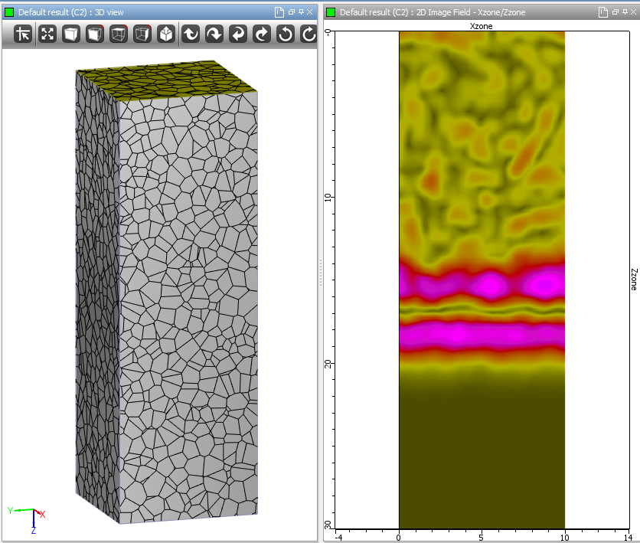

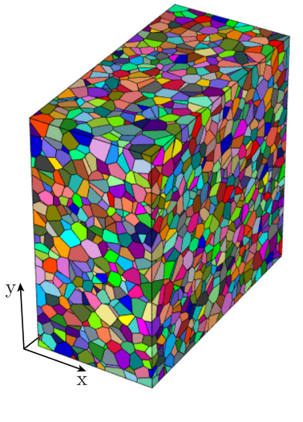
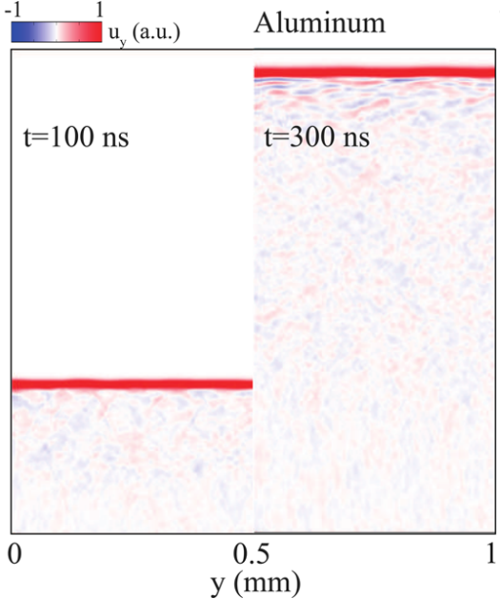
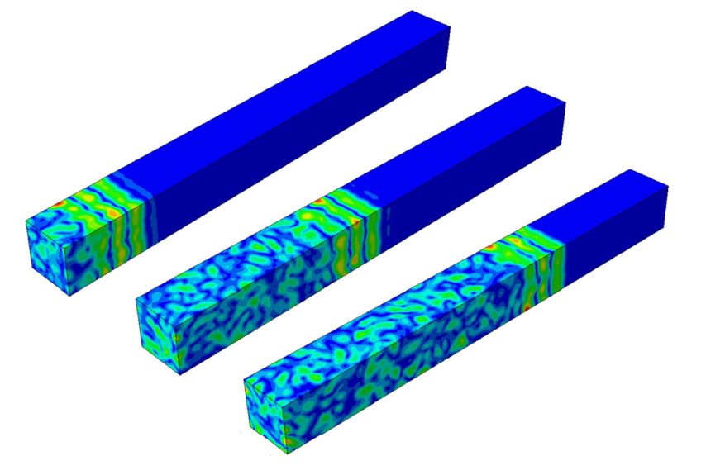
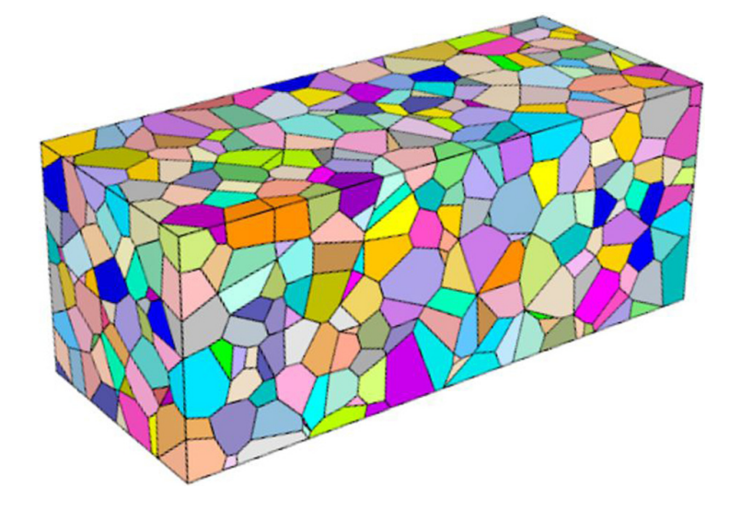
Finite Elements characterization
  Random generation of polycrystalline samples (Voronoi tessellations)
  Low-order transient FEM grid with incident plane wave
  Averaging of the computed field at different propagation distances
  Behavior of the averaged wave in the frequency domain
    Phase shift → velocity
    Amplitude loss → attenuation
[Van Pamel et al., JASA 2015]
[Ryzy et al., JASA 2018]
[Dorval et al., ECNDT 2023]

Slide 17
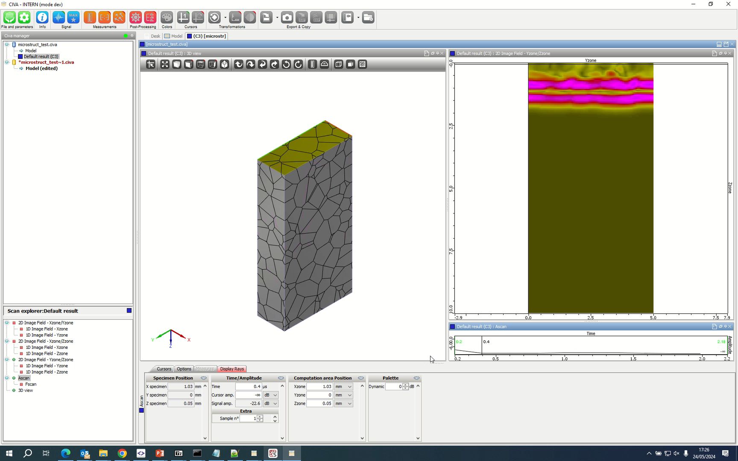











Dedicated module in CIVA (work in progress)
  Towards automated numerical settings
  Random drawing of microstructures for statistical analysis
  Periodic BC for longitudinal & shear waves analysis
$$h\sim L_{G}/10$$
Propagation
Propagation
!
$$W\sim {10 L}_{G}$$
Symmetric BC
Periodic BC
Notes:
Development of a dedicated characterization module in CIVA
Periodic BC also avoids large symmetric grains at boundaries

Slide 18





Examples of results
Attenuation
Velocity
  Steel vs aluminium (strong vs weak anisotropy), same grain size
  Results are consistent with expectations
  50 simulations for each material and each mode (longi, shear)
  5 hours on a laptop for a set of 50 simulations
Sample
Longitudinal wave simulation (steel)
Notes:
Comparisons of steel (strongly anisotropic) and aluminium (weakly anisotropic) for the same grain size →
Results are consistent with expectations
The anisotropy properties at the grain-scale leads to more or less attenuation in the homogenized medium
because the impedance discontinuity between two adjacent grains increases with the anisotropy of each
While the overall equiaxed distribution of grains leads to an isotropic wave-scale homogenized material.
50 simulations…

Slide 19




Simultaneous characterization of both modes
  With appropriate loading, longitudinal and shear waves can be included in a single simulation
  They are easily separated in post-processing due to their different polarization directions
=
+
Attenuation
Velocity
  Results with both modes agree with previous results
  Potential gains in computation times
  Interesting strategy for anisotropic materials
Both waves
Only longitudinal
Only shear
(modulus of displacement)

Slide 20







Anisotropic materials
  Elongated grains and texture can be found in welds or additive manufacturing samples
  One quasi-longitudinal and two quasi-shear waves with different properties
  Proposed solution: project the field on expected polarization directions (Hill average)
$$\left[\begin{matrix}\begin{matrix}\begin{matrix}\begin{matrix}207 \\ 133 \\ 133\end{matrix} \\ \begin{matrix}0 \\ 0 \\ 0\end{matrix}\end{matrix} & \begin{matrix}\begin{matrix}133 \\ 207 \\ 133\end{matrix} \\ \begin{matrix}0 \\ 0 \\ 0\end{matrix}\end{matrix} & \begin{matrix}\begin{matrix}133 \\ 133 \\ 207\end{matrix} \\ \begin{matrix}0 \\ 0 \\ 0\end{matrix}\end{matrix}\end{matrix} & \begin{matrix}\begin{matrix}\begin{matrix}0 \\ 0 \\ 0\end{matrix} \\ \begin{matrix}117 \\ 0 \\ 0\end{matrix}\end{matrix} & \begin{matrix}\begin{matrix}0 \\ 0 \\ 0\end{matrix} \\ \begin{matrix}0 \\ 117 \\ 0\end{matrix}\end{matrix} & \begin{matrix}\begin{matrix}0 \\ 0 \\ 0\end{matrix} \\ \begin{matrix}0 \\ 0 \\ 117\end{matrix}\end{matrix}\end{matrix}\end{matrix}\right]$$
$$\left[\begin{matrix}\begin{matrix}\begin{matrix}\begin{matrix}207 \\ 133 \\ 133\end{matrix} \\ \begin{matrix}0 \\ 0 \\ 0\end{matrix}\end{matrix} & \begin{matrix}\begin{matrix}133 \\ 237 \\ 103\end{matrix} \\ \begin{matrix}0 \\ 0 \\ 0\end{matrix}\end{matrix} & \begin{matrix}\begin{matrix}133 \\ 103 \\ 237\end{matrix} \\ \begin{matrix}0 \\ 0 \\ 0\end{matrix}\end{matrix}\end{matrix} & \begin{matrix}\begin{matrix}\begin{matrix}0 \\ 0 \\ 0\end{matrix} \\ \begin{matrix}67 \\ 0 \\ 0\end{matrix}\end{matrix} & \begin{matrix}\begin{matrix}0 \\ 0 \\ 0\end{matrix} \\ \begin{matrix}0 \\ 117 \\ 0\end{matrix}\end{matrix} & \begin{matrix}\begin{matrix}0 \\ 0 \\ 0\end{matrix} \\ \begin{matrix}0 \\ 0 \\ 117\end{matrix}\end{matrix}\end{matrix}\end{matrix}\right]$$
  Problem: separate mode contributions
Elastic constants of monocrystal (Gpa)
Anisotropic Hill average (Gpa)
  Estimation of polarizations for the 3 modes
  Christoffel equation for propagation direction
Equiaxed grain
Untextured crystal. orient.
Elongated grain
Textured crystal. orient.
Further details in [Dorval et al., AFPAC, 2024]

Slide 21


Anisotropic materials
  Elongated grains and texture can be found in welds or additive manufacturing samples
  One quasi-longitudinal and two quasi-shear waves with different properties
Attenuation
Velocity
  The three modes are successfully separated
  Full characterization requires simulations at all angles
  Fit an effective quasi-hexagonal homogeneous medium
Equiaxed grain
Untextured crystal. orient.
Elongated grain
Textured crystal. orient.

Slide 22










Work in progress & prospects
Micro-scale FEM development in CIVA (2027)
  Extend the analysis of the textured medium at all angles
  Study the calibration of an effective structural noise model
THANK YOU FOR YOUR ATTENTION
Macro-scale FEM release in CIVA (2025)
  To complete the standard CIVA approach (SCC, weld, etc.)
  Study the variability of inspection w.r.t. grain scale uncertainties

Slide 23
Two-scale finite element simulations for UT inspection of micro-structured materials in CIVA
Edouard Demaldent, Nicolas Leymarie, Vincent Dorval, Alexandre Imperiale, Thibaud Fortuna
Université Paris-Saclay, CEA, List, F-91120, Palaiseau, France
Notes:
So i now focus on this task with grain scale simulation

Slide 24





R&D on FEM at CEA
  Validate/complete standard semi analytical models (ray tracing, KGTD...) in critical cases
  Gradual introduction of transient FEM and hybrid tools
  Compatible with a standard PC: NDT studies in 2D, a few shots or scans in 3D
2025
2027
  SHM
  Flaw response
  Part & Defect
  Microstructure
…
Notes:
This motivates the gradual introduction of finite element-based calculation kernels in CIVA to qualify or complete the fast semi-analytical models for these complex cases, as here in the presence of SCC-like branched cracks, for weld inspection, microstructure characterization, and already for SHM simulation using guided waves.

Slide 25


Extension to CAD 2D & 2D5
  Trade off between performance & accuracy & accessibility
  2D CAD + extrusion (Co-axial part & defect extrusion, co-axial contact sensor)
  Prismatic high-order triangle-based FEM with automatic CAD meshing process
  Weld material description (in dev: composite, concrete…)
2025
2.5D part & defect & probe
Notes:
At some point it becomes difficult to ensure a good quality of the automatic meshing with quadrilateral and hexagonal elements, typically when we combine a complex defect with a complex material.
In order to ensure a good trade off between performance and accuracy and accessibility in CIVA, we also propose high-order triangle based FE to mesh 2D CAD files or parametric shapes, coupled with quadrilaterals everywhere we can
Then the 2D mesh is extruded in the third direction to proceed to 3D simulation
yet with a coaxial extrusion of parts and defects, as well as coaxial contact sensors.
These limitations enable us to offer automated meshing tools in CIVA.

