Slide 1


Modelling the Influence of the Tube Support Plate on the Eddy Current Testing of the Steam Generator
Sensitivity study and validation
Edouard Demaldent¹, Audrey Vigneron¹, Jean-Marc Decitre², Thierry Sollier²
¹ Université Paris-Saclay, CEA, List, F-91120, Palaiseau, France
² IRSN, France
Notes:
This is a joint work between IRSN and CEA List, to which I belong.

Slide 2
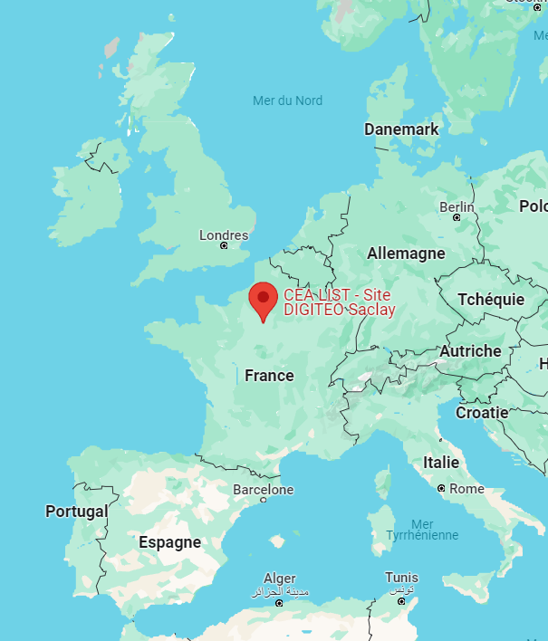
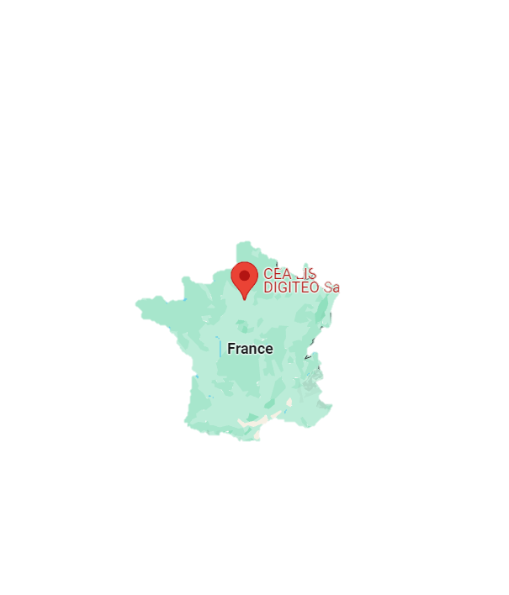
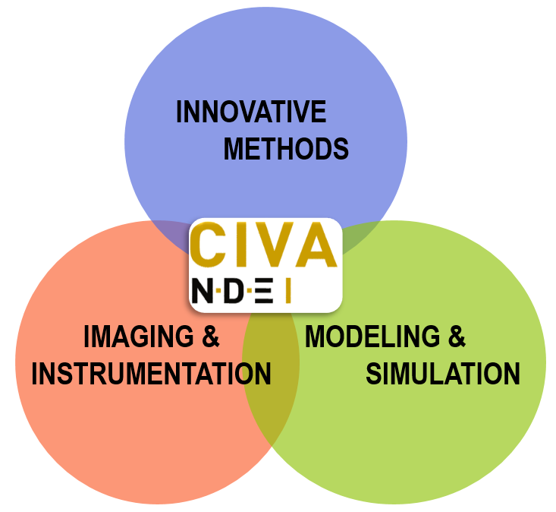



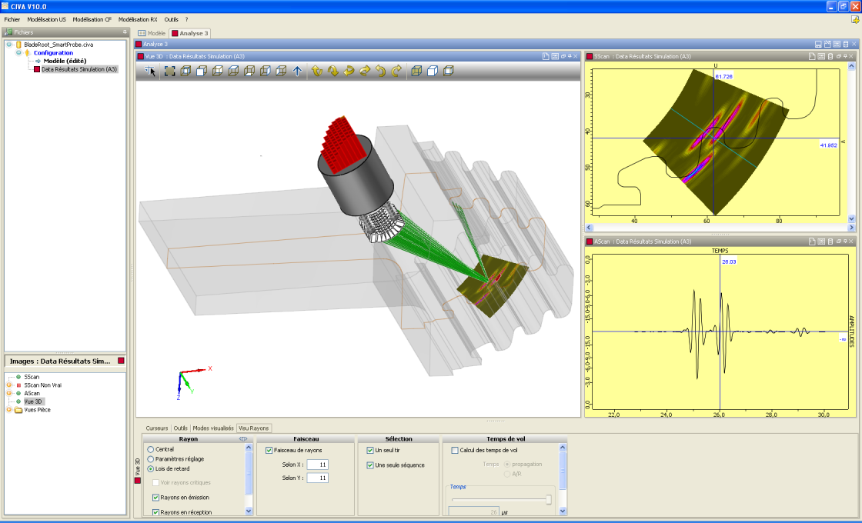
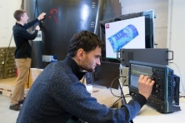

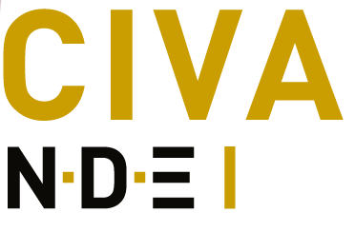

Non destructive evaluation at CEA List
01
02
03
NDE team at CEA List : ~ 110 staff members
including 25 PhD & post-doc
Large industrial partnership in main sectors concerned by NDE
Strong academic collaborations : through CIVA network, National, European and International projects, …
Three-fold R&D activity
Experimental & numerical platforms
Addressing the main NDE modalities:
Ultrasound, Electromag. (ET,…), X-Ray & CT, Guided Waves, Thermography (IR), …
Notes:
We are more than 100 staff members working on NDE at CEA LIST, in France, near Paris
With both academic and industrial strong partnerships in France and abroad.
With both instrumentation and simulation skills to promote innovative inspection solutions or to demonstrate the performance of existing ones
We share these skills with our partners through experimental collaborative platforms in our lab that is located near Paris in France

Slide 3






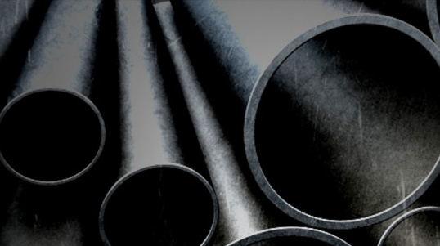
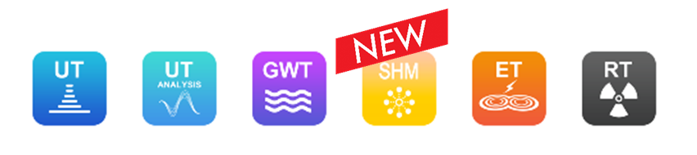




NDE simulation software platform
WORLD LEADER
IN NDT SIMULATION
A multi-technique software platform
2020
Developed by CEA-List
Distributed by EXTENDE
CIVA USERS: More than 300 companies
and Labs in 40 countries
2020
2021
2022
NDE Simulation and analysis
  Integrate basic research achieved at CEA List
  Release annual versions containing new tools
  Collaborative platform, Plug-In technology
Notes:
We are developing the CIVA simulation and analysis software platform, which is distributed by extende.
We gradually integrate our modelling research work in the main NDT fields.
And this presentation concerns the electromagnetic testing module

Slide 4
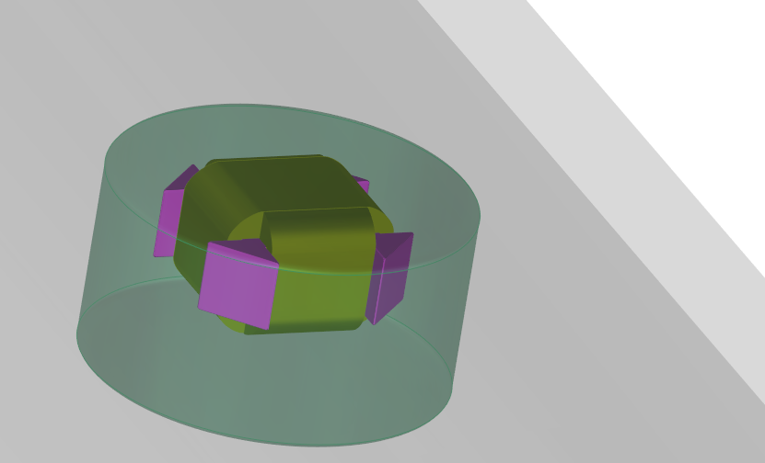

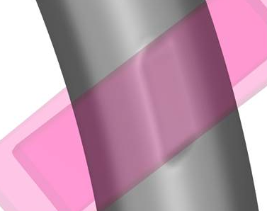
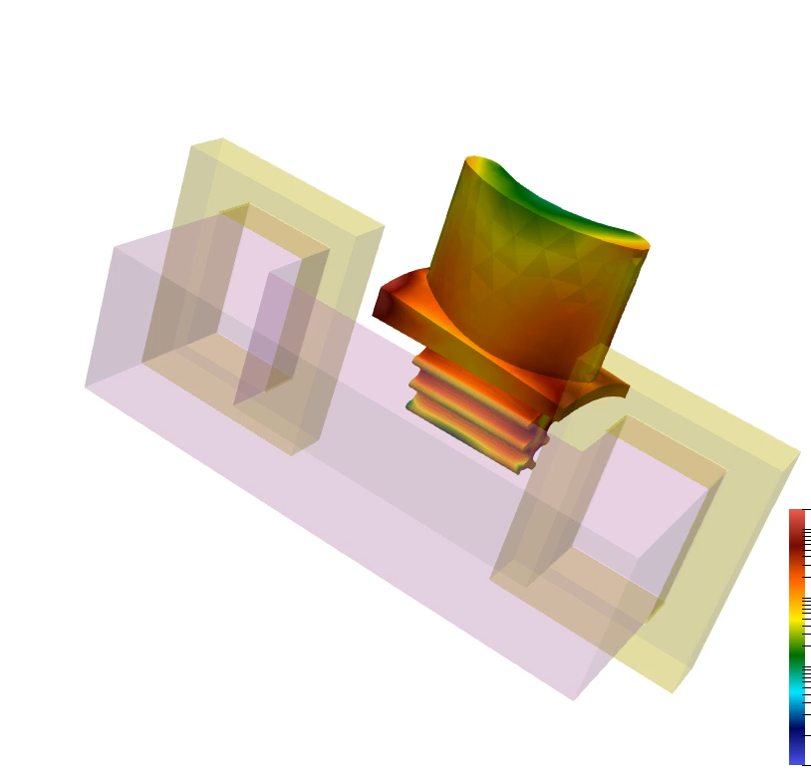
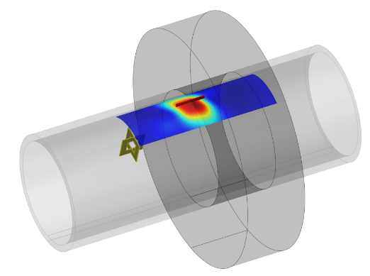
Eddy Current Modelling at CEA
  Simulation tools are chosen according to their performance and their domain of validity
Models coupling for fast simulation
Tu.O.E.2.1
Today’s presentation
Models assisted…thermographic Tu.O.I.1.4
Semi-analytical tools for deposits & cylindrical support plates
Hybridization with numerical tools for industrial probes
Numerical tools for exploring simulation on 3D geometries
Simulation of EC heat induction
(3D Boundary Element Method)
Notes:
Different families of models are proposed within this electromagnetic module,
First of all, semi-analytical models with very high-performance but restricted to canonical geometries,
Various coupling strategies to augment them, for example to take account of a 3D ferrite core in the probe
We also develop full 3D numerical models that are usefull on complex geometries, as illustrated here on the right for electromagnetic heat induction simulation,
Last Tuesday, my colleague Christophe Reboud introduced most of these models.
And today's work involves modelling the inspection of SGs tubes using a 3D numerical model.

Slide 5
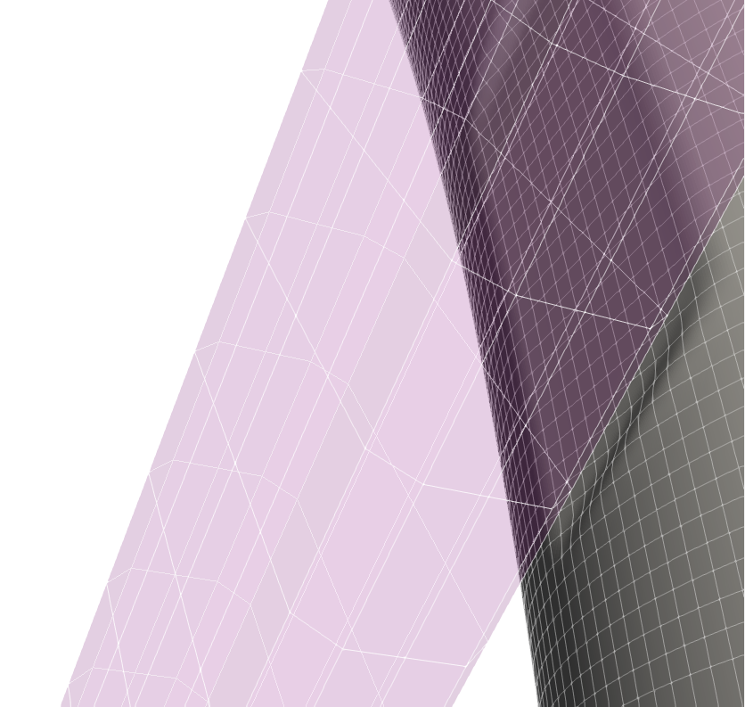
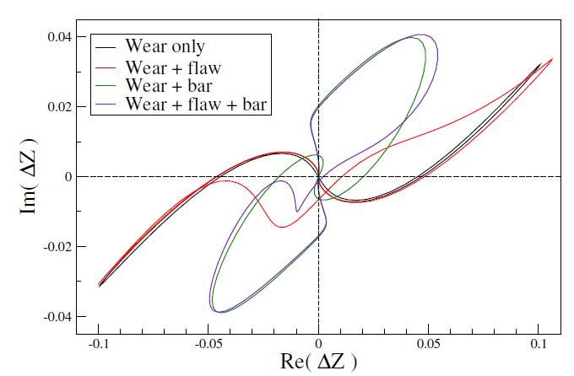
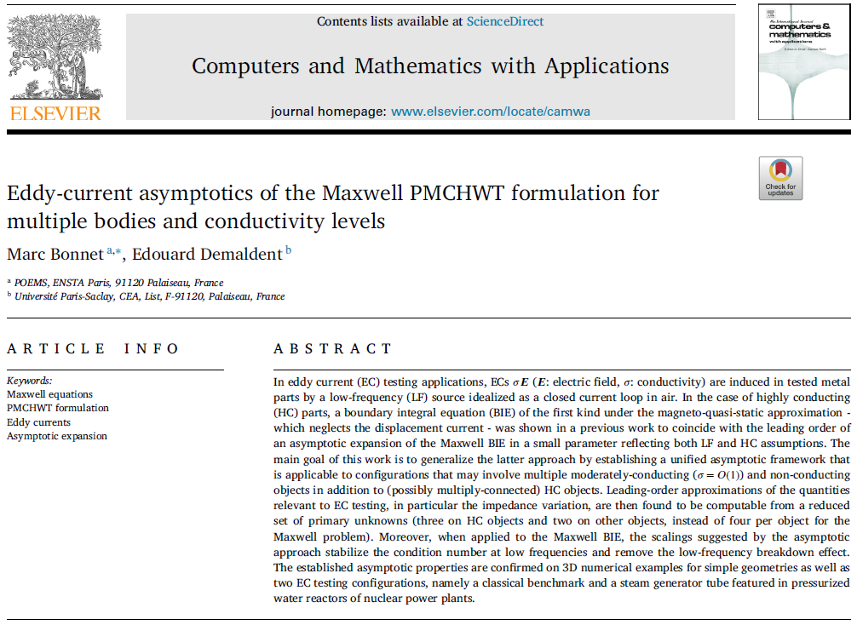
Eddy Current Modelling at CEA
  Simulation tools are chosen according to their performance and their domain of validity
  SG tube inspection module based on a 3D BEM within CIVA ET
Original Boundary Element Method (BEM) – robust for ECT - homogeneous objects
Full (1D) scan simulation in a few minutes to one hour on PC
Automatic meshing process with (curved) surface elements
Further Mathematical details in
[M. Bonnet & E. Demaldent, CAMWA, 2023]
Notes:
There is now a CIVA module dedicated to the inspection of steam generator tubes, which is based on a 3D Boundary Element Method
We have developed an original formalism that is robust enough to support ECT simulations
I don’t want to go into details but let say that with BEM we only mesh the surface of each homogeneous object and not the volume,
especially not the air gap between two close objects.
This drastically simplifies the automatic preparation of the simulated inspection scene, which is essential within the CIVA software framework.

Slide 6
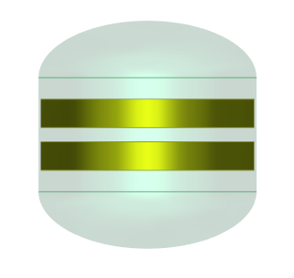

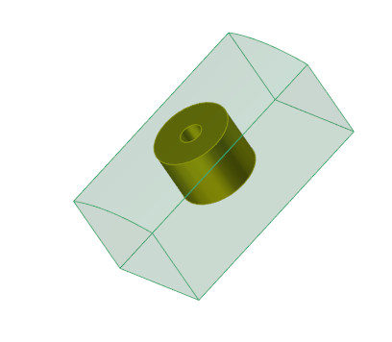
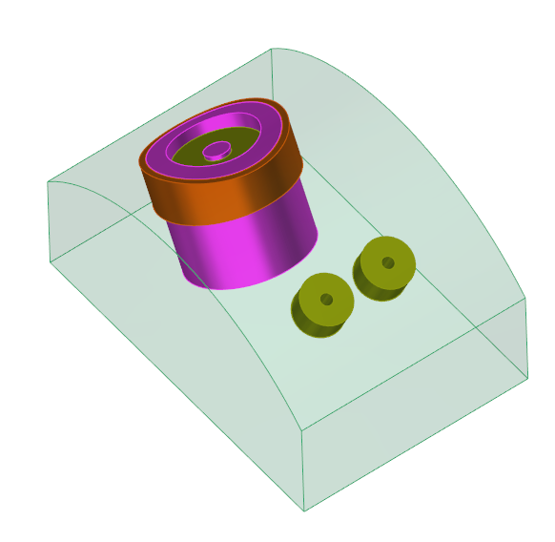
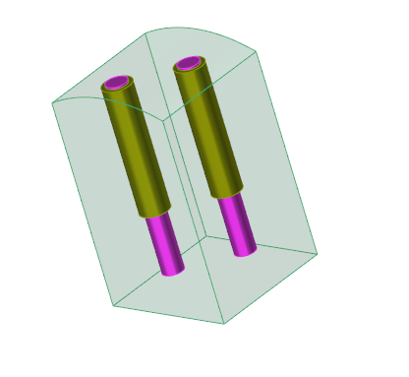
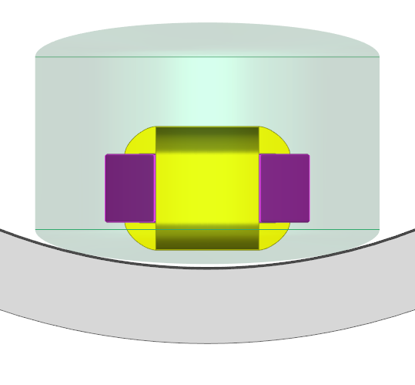
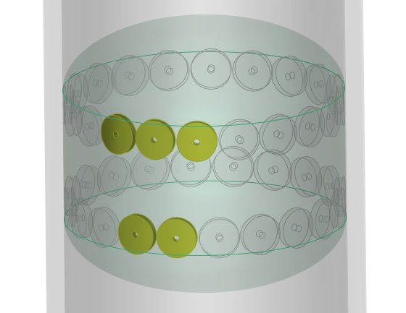

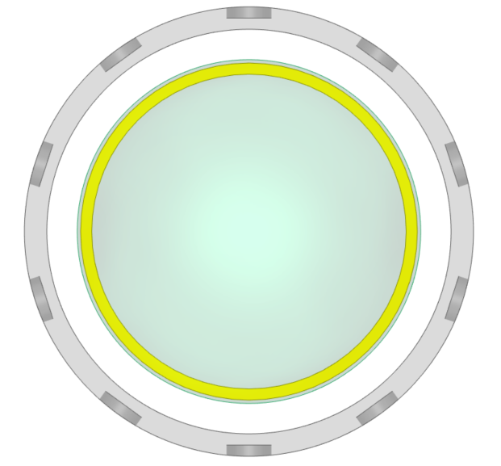
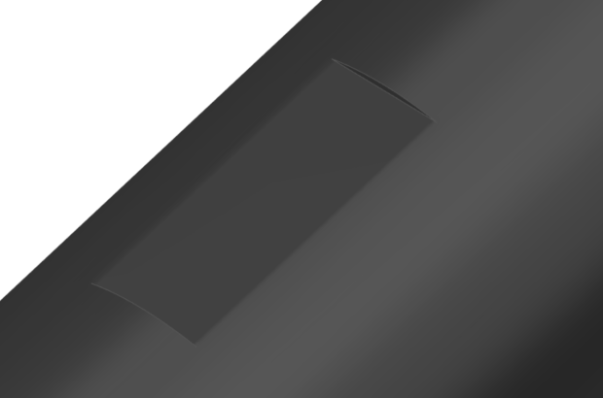
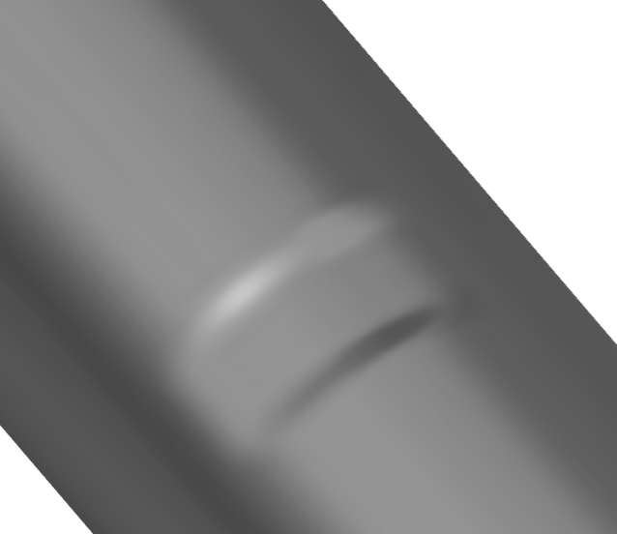
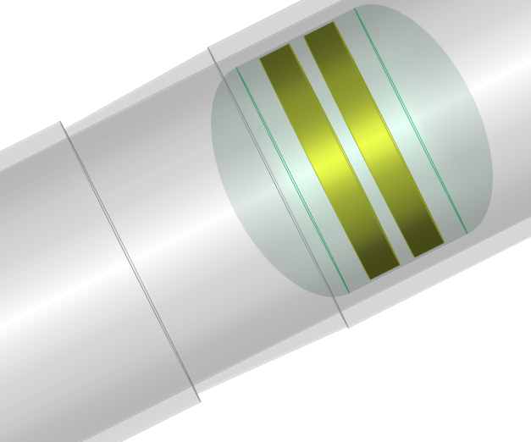
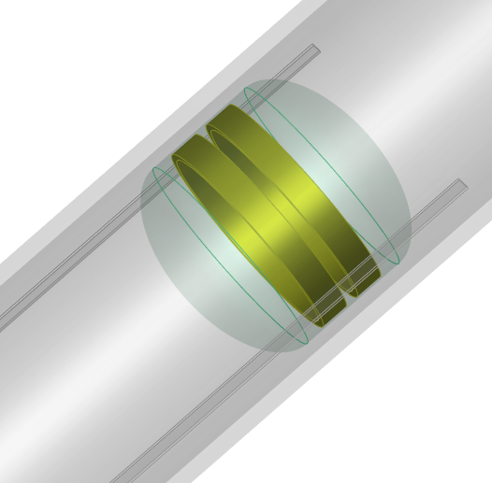
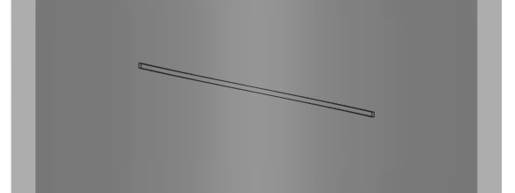
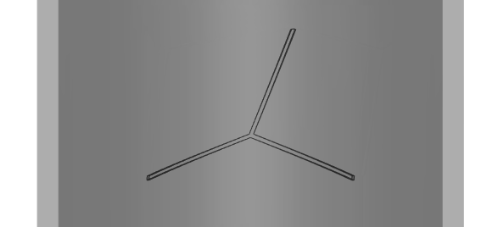
Eddy Current Modelling at CEA
  Simulation tools are chosen according to their performance and their domain of validity
  SG tube inspection module based on a 3D BEM within CIVA ET
  Access to simulation of complex parametric inspections
Probes: bobbin coils (available), rotating probes, multi-element (incoming)
2025
Bobbin Coils
+point®-like
xprobe®-like
Defect: Calibration defects, hole, straight wear, bump, groove, progressive groove, notches…
10 holes
Notes:
The advantage of this module is that it gives access to fairly complex inspection configurations that are still parametric to ensure compatibility with sensitivity studies.
Different kinds of probes and defects can be combined, such as missing material, wear defects and more or less complex notches.
Axial bobbin coils are already available, rotating probes like the plus point probe, as well as multi-element probes like the xprobe are incoming.

Slide 7
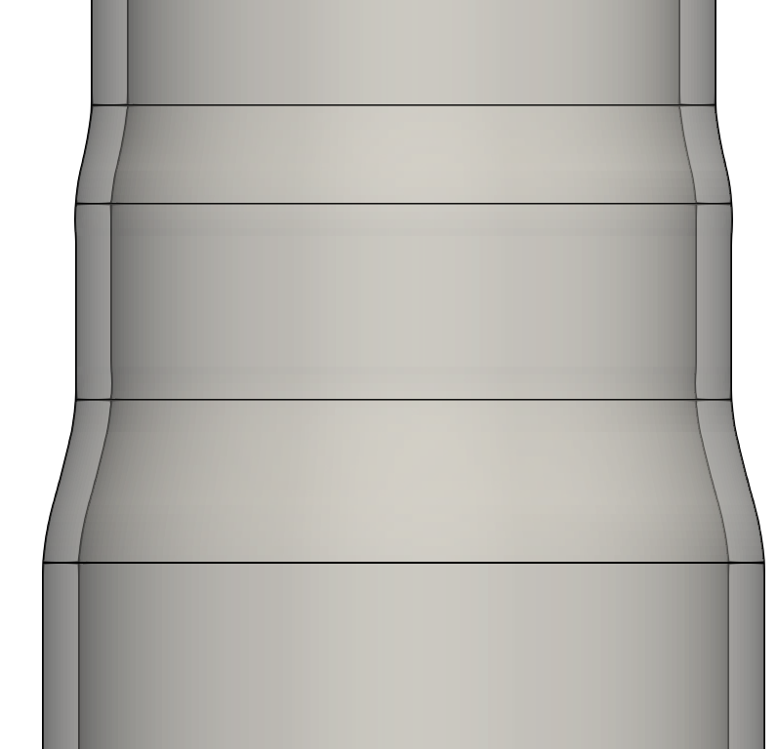
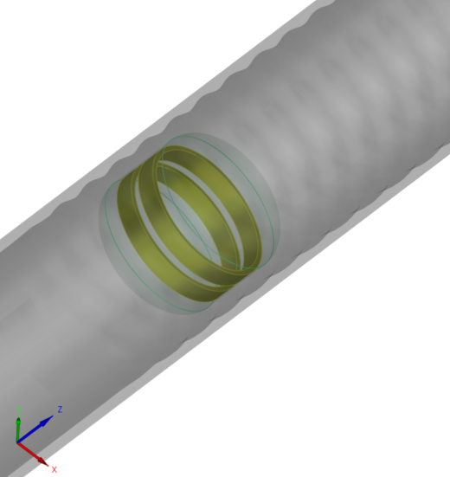
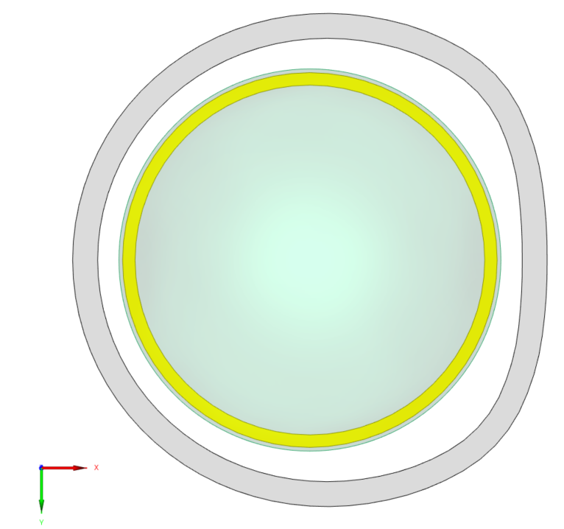
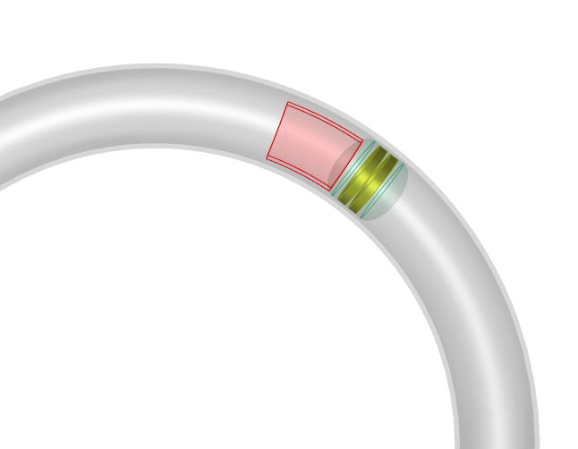
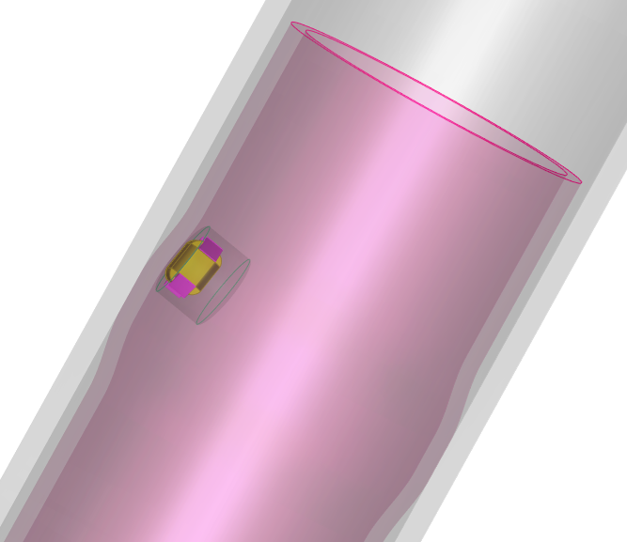
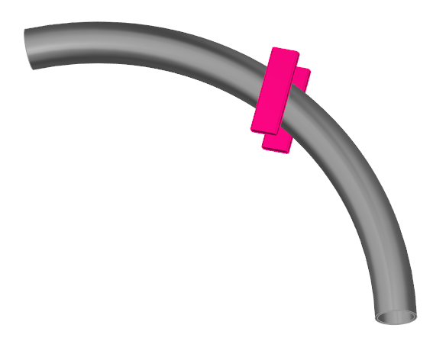
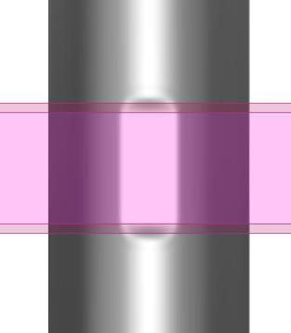
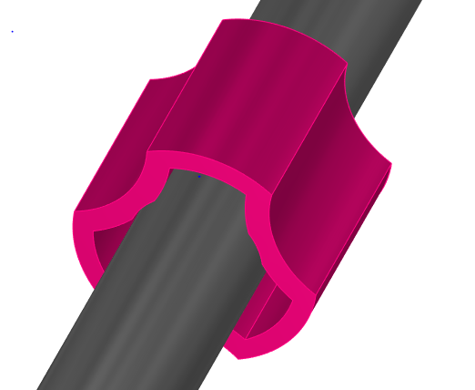
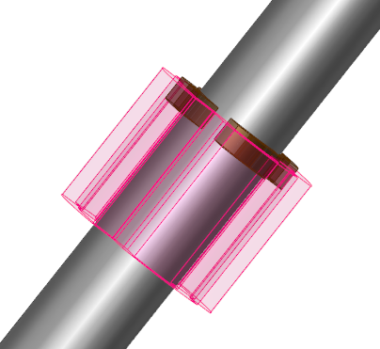
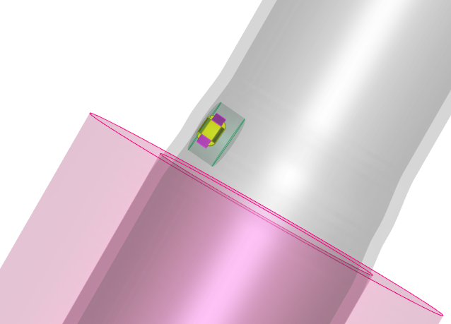
Eddy Current Modelling at CEA
  Simulation tools are chosen according to their performance and their domain of validity
  SG tube inspection module based on a 3D BEM within CIVA ET
  Access to simulation of complex parametric inspections
Tube geometry: expanded, pilgering or section distorsion, U-bend (available), sleeve (incoming)
2025
External objects: antivibration bars, trifoiled support plate, quadrifoiled SP, cylindrical SP…
Notes:
It is also possible to combine various tube deformations such as an expanded section, pilgering effects, distortions with small-radius U-bend tubes, and in the next release sleeving inspection.
And external objects can be added, such as anti-vibration bars, cylindrical, trifoiled or quadrifoiled support plates, and so on and so forth.

Slide 8
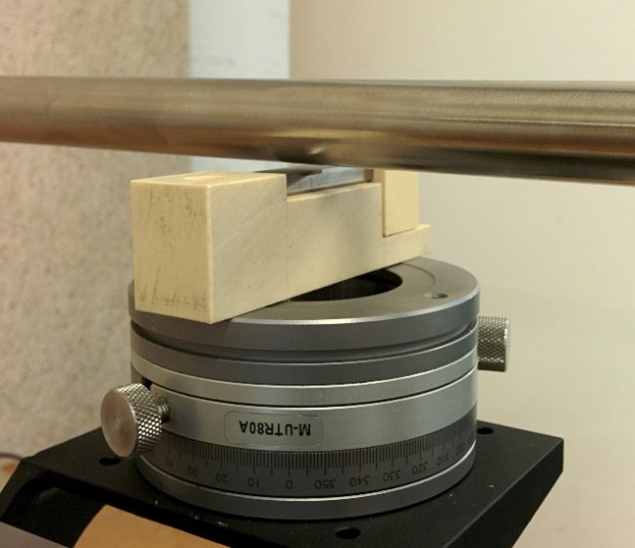
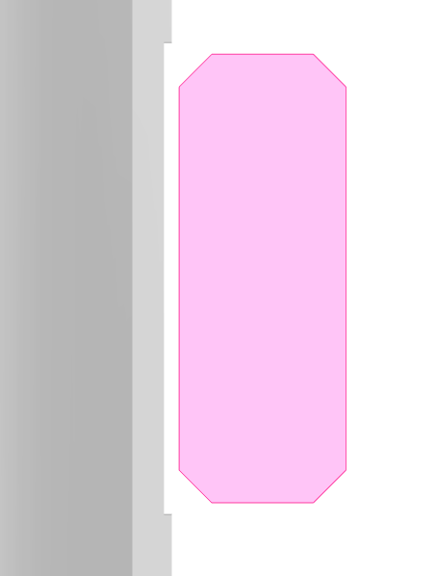
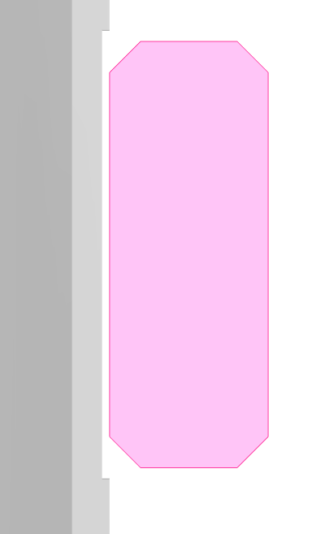
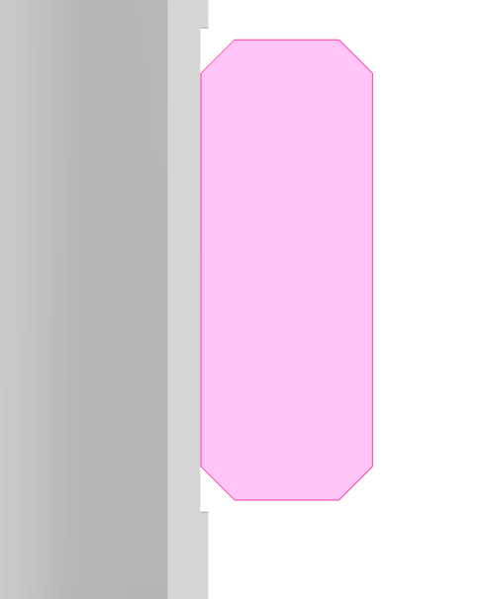
Eddy Current Modelling at CEA
  Simulation tools are chosen according to their performance and their domain of validity
  SG tube inspection module based on a 3D BEM within CIVA ET
  Access to simulation of complex parametric inspections
  Sustained experimental validation work with partners
Further details in [Vigneron et al., e-JNDT, Cofrend 2023]
Notes:
We therefore dispose of a wide range of options with this module
And we ensure the quality of our model by supporting experimental validation activities in collaboration with our partners, especially with IRSN.
For example, here is the signal for a wear defect under an anti-vibration bar for different gaps between the bar and the tube, which is an uncertainty parameter in real life inspection.
Here the gap is of 0.4 mm on the left, 0.2 mm in the middle and the bar is in contact with the tube on the right.
The orange curve corresponds to the experiment and the blue to the simulation.
We consider that the agreement is very convincing and validates the use of such simulation to assist and enrich industrial studies on this particular topic.

Slide 9
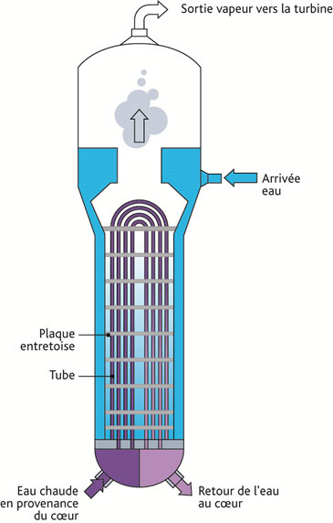
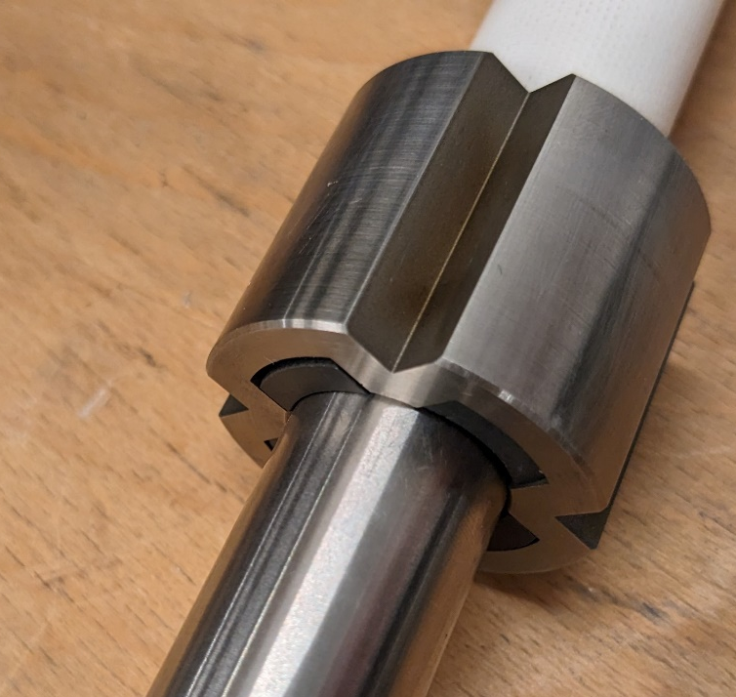
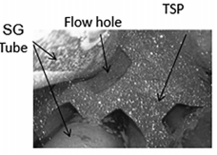
Eddy Current Modelling at CEA
  Simulation tools are chosen according to their performance and their domain of validity
  SG tube inspection module based on a 3D BEM within CIVA ET
  Access to simulation of complex parametric inspections
  Sustained experimental validation work with partners
  What follows: Support plate & Clogging – bobbin coil & +point® - Sim. & exp. Validation
Steam outlet
Warning
Industrial probes with magnetic components interacting with the magnetic TSP
Do simulation predicts the right trends with a simple calibration process?
Water inlet
Anti-vibration bar
Bobbin Coils
Tube support plate (TSP)
Clogging
Primary fluid circulation
Clogging
+point®-like
Notes:
In what follows, we want to apply the same approach to validate the inspection under tube support plates (TSP), and more particularly in presence of a clogging
Indeed, there is a safety concern related to the build-up of deposits in the TSPs flow holes that can form a clogging
From an NDT point of view, detecting such clogging with commonly used axial bobbin coils, and characterizing them with rotating probes, is of great interest.
[click]
From a simulation point of view, the difficulty is greater than in our previous studies.
we will use industrial probes which contain magnetic components that interact with the strongly magnetic plate.
the EM properties of these components are not well known and anyway may vary from one manufacturer to another,
So an important issue is to know if simulation predicts the right trends with a simple calibration process.

Slide 10
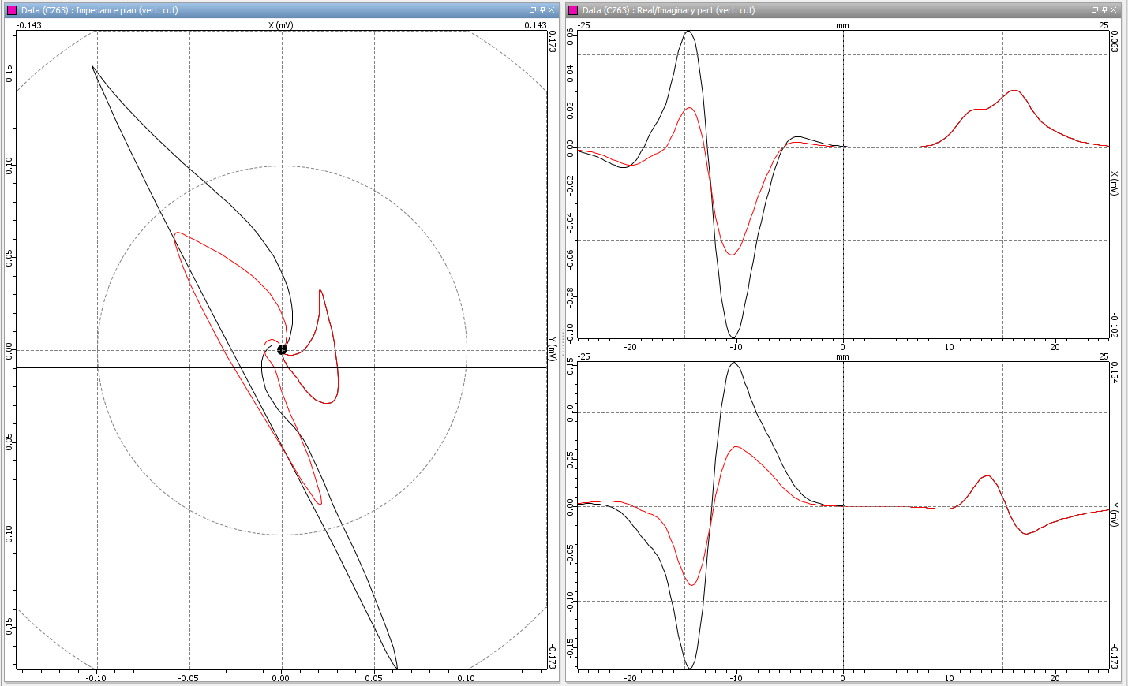
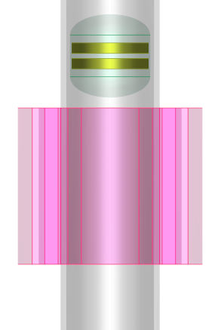
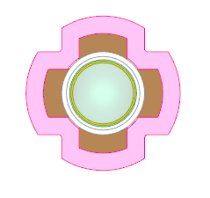
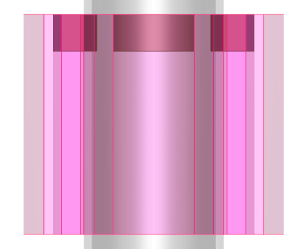
Simulation Study
  Significant variation in the simulated signal as a function of many uncertain input parameters
Material variation
μ_{r} = 6
μ_{r} = 2
Clogging geometry
Probe displacement
Clogging position
Further details in [Vigneron et al., e-JNDT, NDE in Nuclear 2023]
280 kHz, Differential mode, steel plate (σ=1.75 MS/m, μ_{r} = 50)
Notes:
We first run the software to simulate various clogging configuration, here with the axial bobbin coil operating in differential mode.
Here we show the simulated signal with the quadrifoiled support plate and clogging, the real part is at the top, the imaginary part at the bottom, and the lissajou at the left.
In this lissajou, the right -hand side contribution corresponds to the side of the plate without clogging, and the left-hand side corresponds to the plate + clogging for 2 distinct permeabilities.

Slide 11
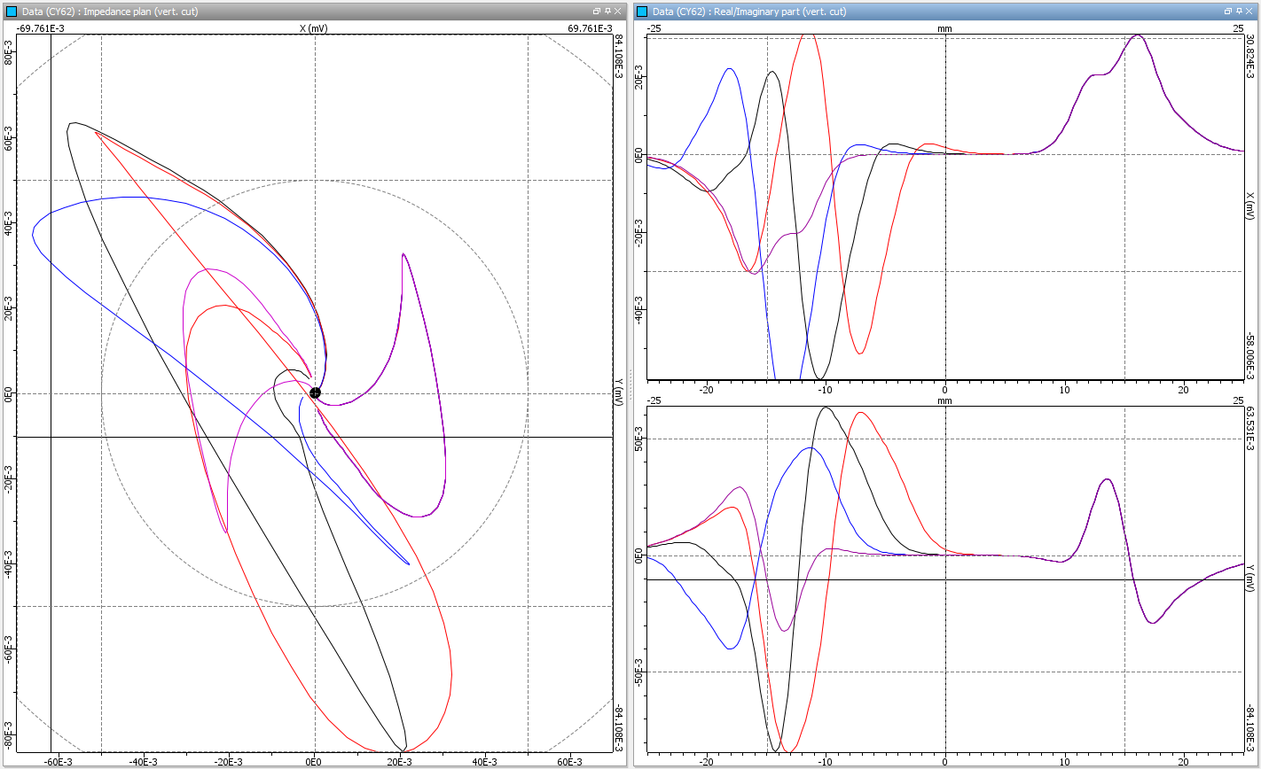


Simulation Study
  Significant variation in the simulated signal as a function of many uncertain input parameters
Position variation
Clogging geometry
Probe displacement
Further details in [Vigneron et al., e-JNDT, NDE in Nuclear 2023]
280 kHz, Differential mode, steel plate (σ=1.75 MS/m, μ_{r} = 50)
Notes:
Here we compare the simulated signal for a fixed permeability with various positions of the clogging

Slide 12






Simulation Study
  Significant variation in the simulated signal as a function of many uncertain input parameters
Shape variation
Probe displacement
position
Further details in [Vigneron et al., e-JNDT, NDE in Nuclear 2023]
280 kHz, Differential mode, steel plate (σ=1.75 MS/m, μ_{r} = 50)
Notes:
And here for various shapes of the clogging with a constant volume of deposit and fixed position.
So as you can see, we are facing significant variation in the simulated signal as a function of many input parameters that are not known in real inspections
And this drives the need for robust and validated modelling tools

Slide 13






Experimental Set Up
Steel cyl. STP
Steel quadri STP
P265GH
1300MW SG tube
σ = 0.87 MS/m
Stainless steel cyl. STP
σ = 1.4 MS/m
Ferrites
µ_{r} ~100
stainless steel quadri STP
+point® Zetec
Rotating bench (+point)
Translating bench (Bobbin coils)
Notes:
The experimental study was performed on inconel tubes with standard machined flaws,
with two sets of quadrifoiled and cylindrical plates, one set made of stainless steel and the other of steel, so non magnetic and magnetic plates,
Also several ferrites were machined to be inserted into the plate flow holes as if they were cloggings.

Slide 14



Experimental Set Up
  Each coil operated in absolute mode using an impedance analyzer
  To ensure that any magnetic interaction effects are not masked
Keysight E4990A ®
active bobbin coil
  120 kHz, Calibration 1V 0° Large External Groove 30% 20 mm
Notes:
In real life the probes are operated in differential mode but for this in-lab study, each coil is operated in absolute mode using an impedance analyzer.
From a simulation point of view, achieving accuracy in absolute mode is somehow more difficult, but it does ensure that magnetic interaction effects between the industrial probe and the magnetic plate are not hidden.
(In what follows, the results correspond to a frequency of 120 kHz and are calibrated on a large external groove)

Slide 15


Axial Bobbin Coil
  Stainless steel cylindrical TSP
Exp
Sim
 | Amplitude | Phase
Sim. | 756 | 109
Exp. | 764 | 110
gap | 1 % | 1°
Notes:
We start with the experimental validation of the axial coil for the stainless steel cylindrical support plate.
The black line corresponds to the experiment and the red line to the simulation and you can see that everything is going well.

Slide 16


Axial Bobbin Coil
  Stainless steel quadrifoiled TSP
Exp
Sim
 | Amplitude | Phase
Sim. | 359 | 98
Exp. | 358 | 101
gap | 0.3 % | 3°
Notes:
Now with the stainless steel quadrifoiled plate, so far so good.

Slide 17


Axial Bobbin Coil
  Stainless steel quadrifoiled TSP + ferrite clogging
Exp
Sim
 | Amplitude | Phase
Sim. | 269 | -60
Exp. | 303 | -64
gap | 13 % | 4°
Notes:
Now for the stainless steel quadrifoil plate + ferrite clogging
We can see that the simulation still matches the experimental result quite well, even with the strongly magnetic clogging.

Slide 18

Axial Bobbin Coil
  Steel* cylindrical TSP
Exp
Sim
 | Amplitude | Phase
Sim. | 227 | 134
Exp. | 236 | 137
gap | 4 % | 3°
*in practice µ_{r} = 50, σ = 3,5 MS/m was applied as it fits well the cyl. TSP experimental result
Notes:
We continue with the cylindrical support plate made of steel
Here the match is almost perfect, but the truth is that we chose electromagnetic properties of the plate that are realistic and fit well the experiment
So in some way we cheated, but it was made on purpose as the question is whether this blind choice of electromagnetic settings is still effective on more complex configurations.

Slide 19

Axial Bobbin Coil
Phase shift on the side without ferrite
  Steel quadrifoiled TSP + ferrite clogging
Exp
Sim
 | Amplitude | Phase
Sim. | 355 | -72
Exp. | 359 | -69
gap | 1 % | 3°
Ferrite interaction with the steel quadrifoiled TSP is well predict by simulation
Notes:
And actually it does, as we can see here with the steel quadrifoiled plate + ferrite clogging,
This is a very good experimental validation result.
[click]
But if we take a closer look at the signal on the other side of the plate, without clogging, we see that there is a phase shift on this weaker contribution.
This can be reduced with more optimized electromagnetic properties of the steel plate and by adding the probe core in simulation, as illustrated in our conference proceeding

Slide 20

Axial Bobbin Coil
Exp
Sim µ_{r}=100
Sim µ_{r}=8
Sim µ_{r}=4
  Steel quadrifoiled TSP + ferrite clogging
 | Amplitude | Phase
Sim. | 355 | -72
Exp. | 359 | -69
gap | 1 % | 3°
µ_{r}=4
µ_{r}=8
µ_{r}=100
Simulations of various permeabilities – same signal shape, amplitude drop of the imaginary part
Notes:
But more importantly, here we show additional simulated contributions with a more realistic permeability of 8 or 4 within the clogging.
You can see that the clogging signal keeps the same overall shape, with just a drop in the amplitude of the imaginary part.

Slide 21


Rotating +Point
  Standard calibration flaws – experimental data
Exp. coil 1
Exp. coil 2
  Ext. groove
  40% 1mm
  Int groove
  10% 1mm
  Extenal groove
  30% 20mm
  (calib 1V 0°)
Notes:
Now let’s have a quick look to the rotating +point probe
Here we show the experimental data for each coil operated separately in absolute mode on standard machined flaws such as external and internal grooves

Slide 22

Rotating +Point
  Standard calibration flaws
  Coil 1
Exp. coil 1
Sim. coil 1
Notes:
This is the comparison between simulation and experimental data on these defects for the first coil, and you can see that we obtain a great agreement.

Slide 23

Rotating +Point
  Standard calibration flaws
  Coil 2
Exp. coil 2
Sim. coil 2
Notes:
The same with the second coil

Slide 24


Rotating +Point
  Stainless steel cylindrical TSP
  Coil 1
Exp. coil 1
Sim. coil 1
Notes:
Now the comparison with the stainless steel cylindrical plate for the first coil. Everything is still ok.

Slide 25




Rotating +Point
$$Im(Z)$$
  TSP
  2 ferrites
height
  Stainless steel quadrifoiled TSP + ferrite
  Coil 1
  1 ferrite
0 – 360°
Exp.
Sim
So far so good, simulation predicts the main trends of the signal variation
Work in progress…
Sim
Sim
Exp
Exp
Notes:
And now with the much more complex quadrifoiled plate with various ferrite clogging.
On top this is the imaginary part of the impedance variation inside the tube with respect to the height and the circomference.
We distinguish well the quadrifoiled plate contribution and the clogging contribution, with two ferrite on the left and a single ferrite in the middle
[click]
Here is a comparison of the signal when the probe passes through the centre of the double ferrite, and it all works very well
[click]
The most difficult part to reproduce in this configuration is when you move away from the ferrite in the area where the signal varies progressively.
We can see that the simulation is not perfect, but the trend is respected

Slide 26


Conclusion & perspectives
  SG tube inspection module based on a 3D BEM within CIVA ET
  Support plate & clogging – bobbin coil & +point - Sim. & exp. Validation
  Industrial probes with magnetic components interacting with the magnetic TSP (exp.)
  Simple calibration seems ok to get fairly accurate simulated predictions
  To be confirmed with the rotating +point probe with a steel quadrifoiled plate + ferrite clogging !
THANK YOU FOR YOUR ATTENTION
Single clogging
Double
clogging
TSP
+point probe, coil 1, steel quadrifoiled TSP with double and single ferrite clogging
Notes:
In conclusion, we have introduced a recent simulation module dedicated to SG tube inspection in CIVA
This presentation was focused on the simulation of the tube support plate signal with and without clogging
Industrial probes with an unknown magnetic component were used
But it seems that a simple calibration is ok to obtain accurate simulated predictions, even with magnetic plates
In particular very promising results have been obtained with the rotating +point probe and we are looking for completing our work on the steel quadrifoiled plates
[click] Thank you very much for your attention.

