Slide 1
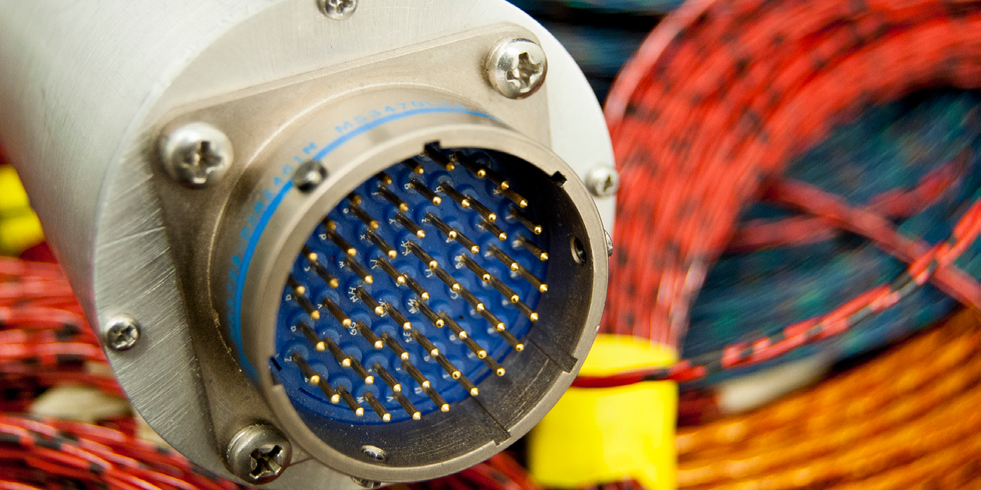


Detecting potential temperature defects on harness of cables with reflectometry

Slide 2
Presentation Overview
General context
  Needs for maintenance on RLV harnesses
  Reflectometry: a promising solution
  Problematics
New simulation model
  RLCG and ABCD description model
  Proposition for a new model
Experimental validation
  Cold spot detection
  Hot spot detection
  Comparison with simulation
Conclusion

Slide 3
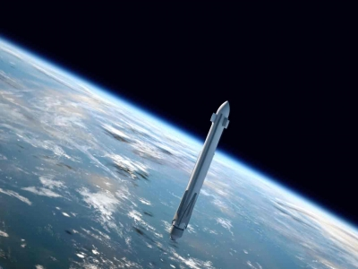
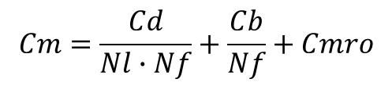
COntext
MRO costs are the key to reusable launch vehicles
$$Cm=\frac{Cd}{Nl∙Nf}+\frac{Cb}{Nf}+Cmro$$
Cm: cost per mission
Cd: developpement costs
Cb: cost for construction
Nl: number of laucnhers per project
Nf: number of flight per launcher
Cmro: mro cost
https://callisto.cnes.fr/en/callisto-0

Slide 4
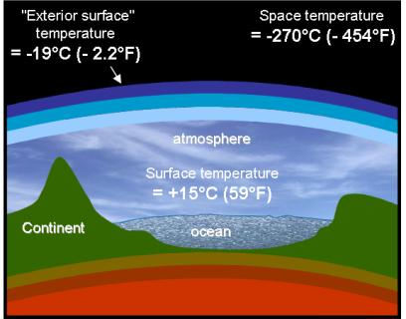

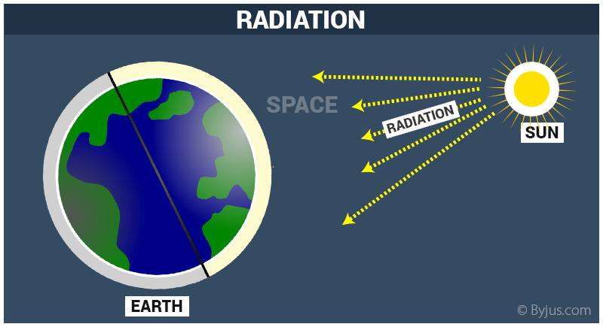
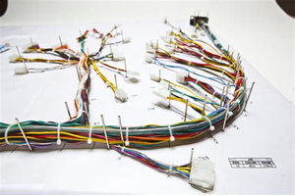
ConStrainTS
Extreme temperatures
High levels of vibrations
Solar radiations
ACCIDENT
All cables are affected, from energy distribution to communication systems

Slide 5

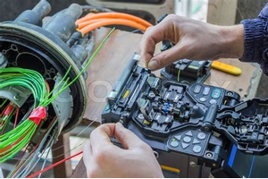



Possible solutions
Harness replacement
Visual inspection
Offline monitoring
Online monitoring
FPGA solution

Slide 6
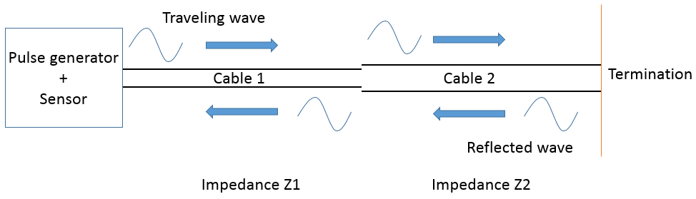
Reflectometry
Reflecometry on cables
  A defect will leave a trace on the voltage measurement
  The propagation time gives the distant to fault
  Harmlessness can be easily demonstrated
A CEA-CNES architecture was proposed in EUCASS-2019

Slide 7
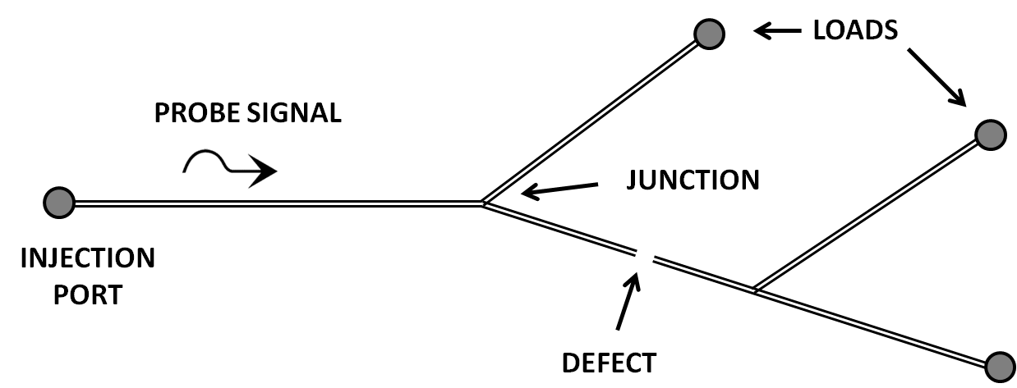
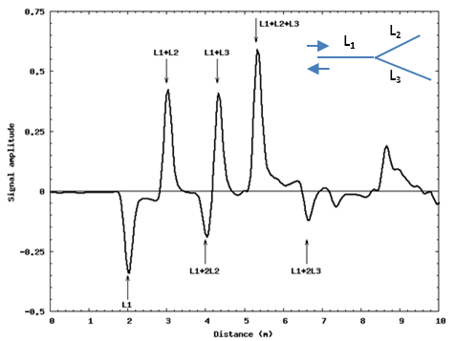
CEA – CNES solution
Limitations
Technical solutions
Complex topology
Distributed sensors
Multiple access to media
TDMA
Several types of defect
Several modes of monitoring
Small electronic architecture
+
analysis on the ground
Limited access to sensors

Slide 8
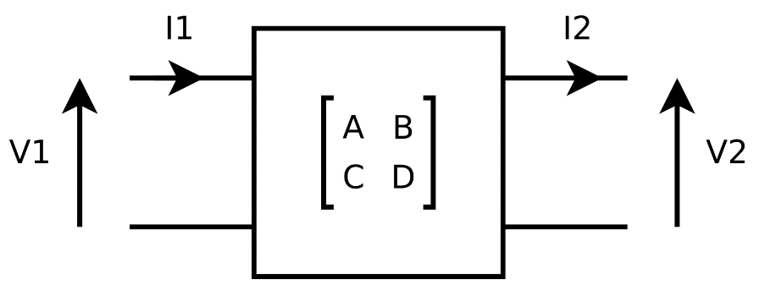
problematics
Previous work made only with simulations
Modeling method is not compatible with defect description
Models of temperature were not tested on real applications
➔ Need for a better simulation model
➔ Need for an experimental validation

Slide 9
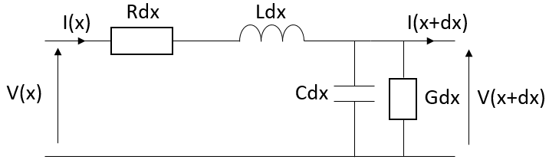
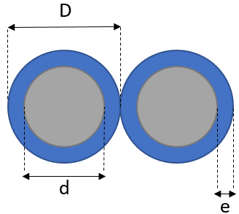
New simulation model
RLCG description
RLCG parameters are function of temperature

Slide 10
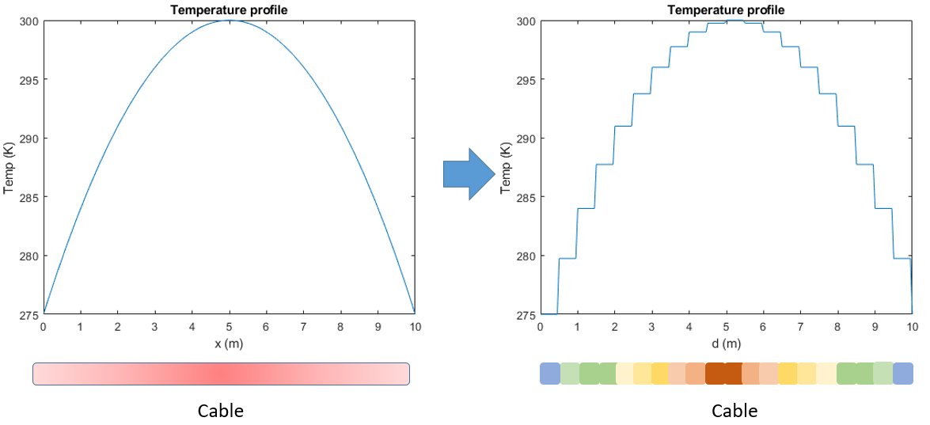
New simulation model
New ABCD model
v
T1
T2
…
TN
Problems:
Additional reflections added by calculus
Computation time may explode

Slide 11
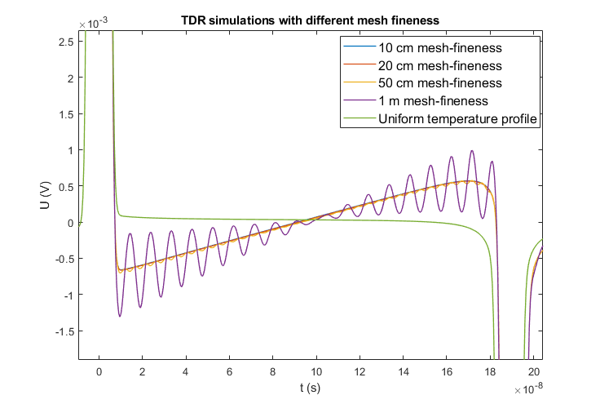
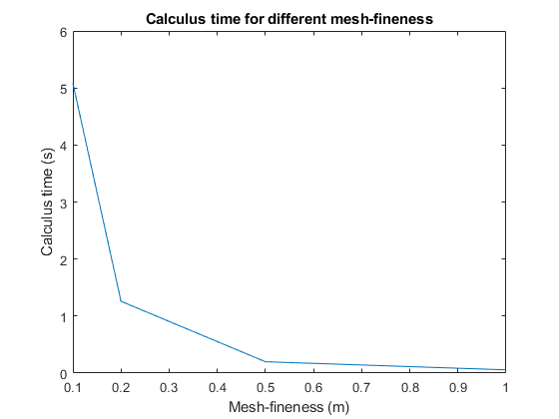
New simulation model
Optimization of the model
Mesh-fineness:
Reflections mitigation: the thinner the better
Mesh-fineness:
Computation time: the larger the quicker

Slide 12
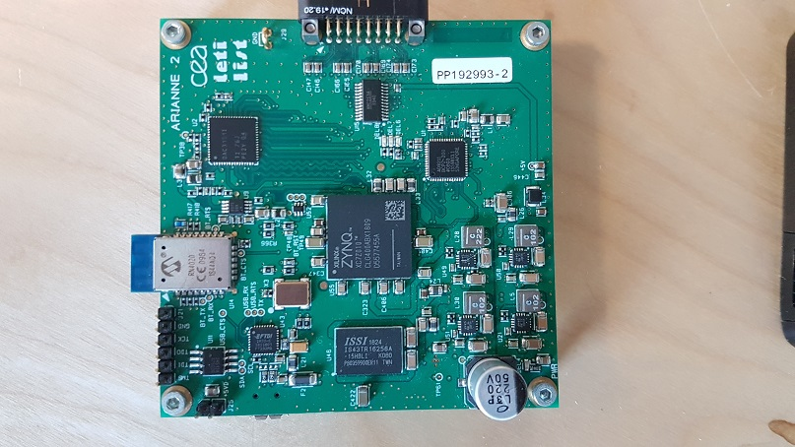
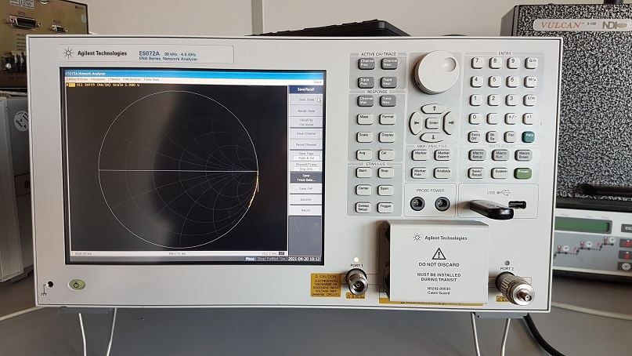
Experimental validation
Measurement devices
CEA sensor:
Basis for an embedded system
Medium level of performances
Cheap
Dedicated to reflectometry measurements
Keysight VNA:
Reference device
High level of performances
Lab use only

Slide 13
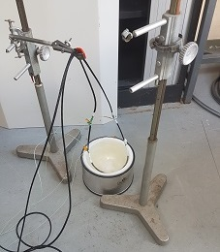
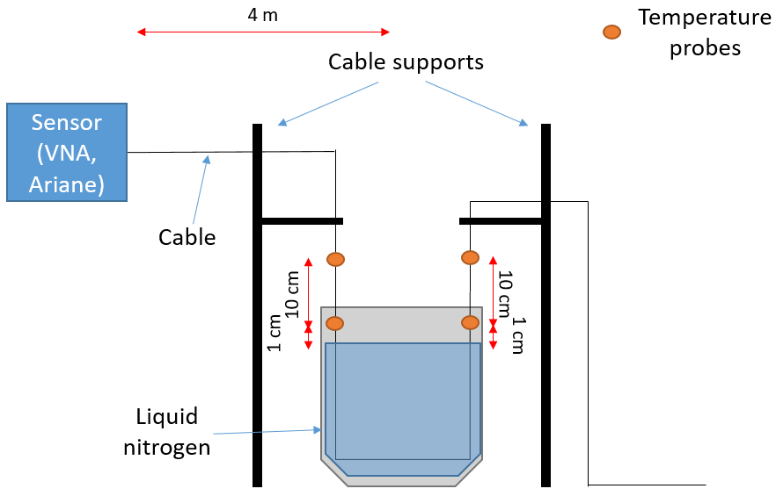
Experimental validation
Cold spot detection
Mastery over the temperature profile
Situation easy to reproduce in simulation

Slide 14
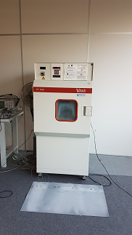
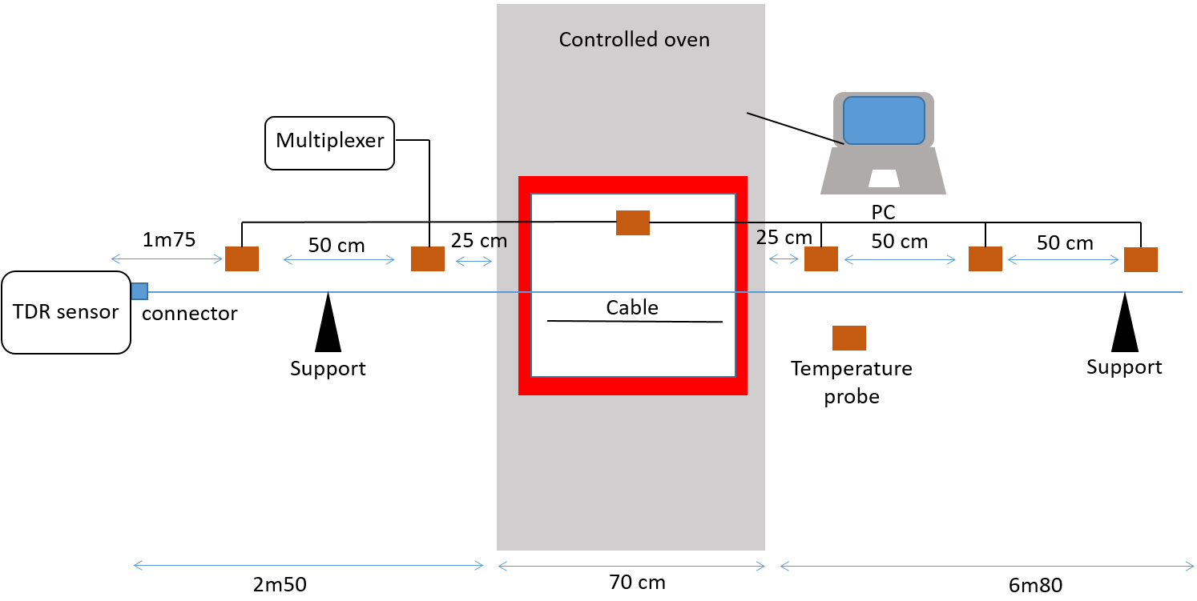
Experimental validation
Hot spot detection
Mastery over the temperature profile
Situation easy to reproduce in simulation

Slide 15
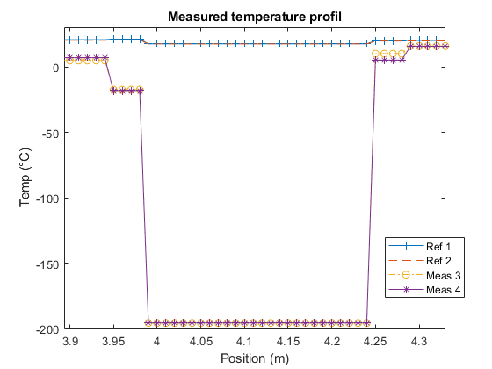
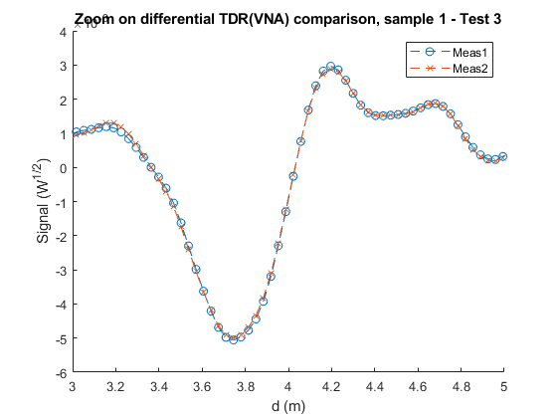
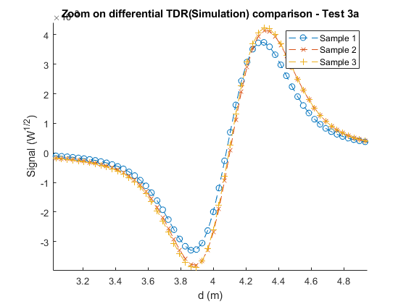
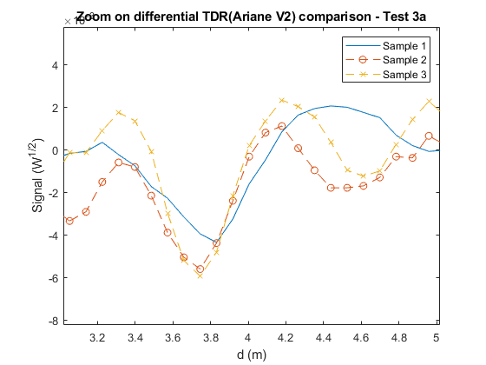
Experimental validation
Comparison with simulation: cold spot
VNA
Simulation
CEA Sensor

Slide 16
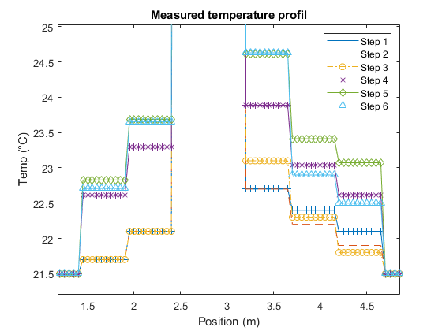
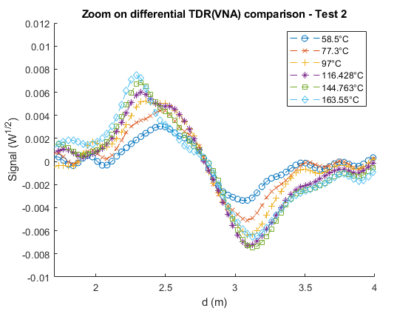
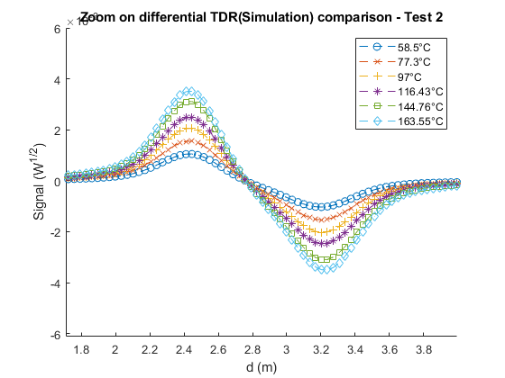
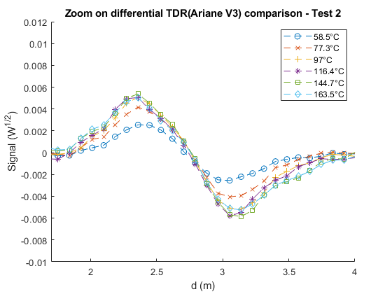
Experimental validation
Comparison with simulation: hot spot
VNA
Simulation
CEA Sensor

Slide 17
Conclusions
Great similarities between simulation and experiment
  Same behavior under temperature stress
  Position and relative magnitude respected
  Small undershooting of the model
  Validation of the new model
  Demonstration of the possibilities to detect temperature defect
Perspectives
  Reproduce and increase the parameters of the test
  Reduce the effect of test bed discrepancies
  Integrate the new model into simulation tools for whole systems

Slide 18
THANK YOU FOR YOUR ATTENTION

