Slide 1
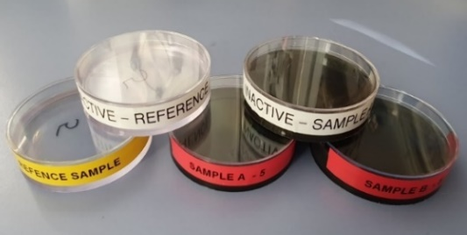
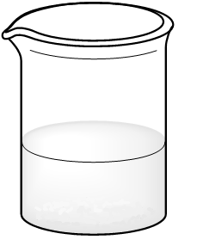
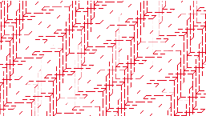
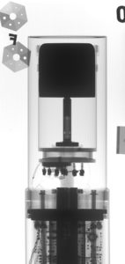
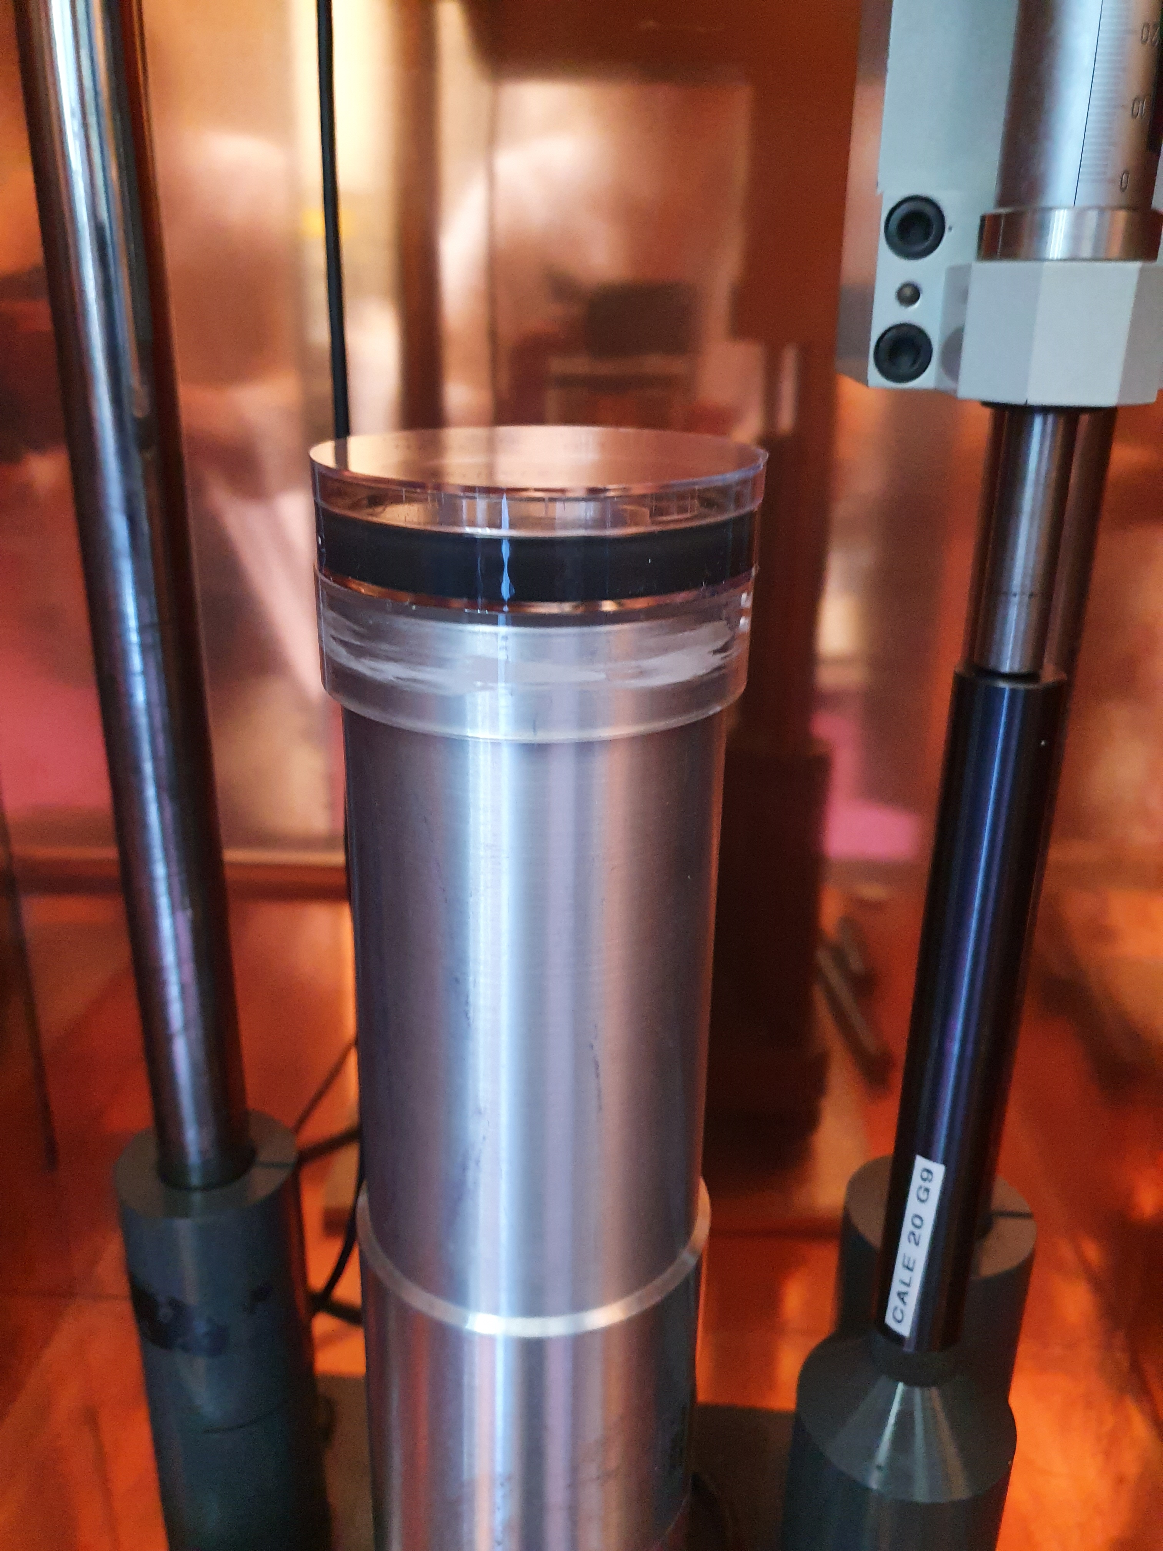
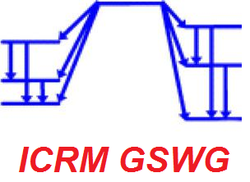
Self-attenuation in the low-energy range: an experimental study on ²¹⁰Pb
ON-GOING EXERCISE OF THE ICRM GAMMA SPECTROMETRY WORKING GROUP
M.-C. Lépy¹, L. Chambon¹, B. Sabot¹, A. De Vismes², R. Galea³, R. Idoeta⁴, P. Jodlowski⁵, K. Kanoutos⁶, K. Karfopoulos⁷, A. Meyer³, I. Mitsios⁶, V. Peyres⁸, P. Saganowski⁹, N. Salpadimos⁷, M.I. Savva¹⁰, O. Sima¹¹, T.T. Thanh¹², R. Townson⁴, Z. Tymiński⁹, T. Vasilopoulou¹⁰, L. Verheyen¹³, T. Vidmar¹³
¹ CEA/LNHB, ² IRSN, ³ NRC, ⁴ UPV/EHU, ⁵ AGH UST, ⁶ NTUA, ⁷ EEAE, ⁸ CIEMAT, ⁹ POLATOM, ¹⁰ NCSR “Demokritos”, ¹¹ U. Bucharest, ¹² VNUHCM, ¹³ SCK CEN
Motivation: Quantitative analysis of environmental samples generally involves volume source with low radioactivity and an unknown composition of the sample matrix. Unless an efficiency calibration with the same geometry and matrix is available, it is necessary to correct the raw counting rates for self-attenuation effects in order to obtain the correct sample activity.
This exercise focuses on the different steps required to calculate the final activity of unknown matrices, based on the calibration obtained with a reference matrix, in the same geometry. This includes: measurement of the linear attenuation coefficients, calculation of self-attenuations (between void and solid sample) and self attenuation corrective factors (between reference and unknown matrices).
4 batches circulating between 12 laboratories
Reference date: 1^{rst} October 2022 – 12:00:00 UTC
 | Half-life (a) | Photon emission energy (keV) | Photon emission intensity (%)
²¹⁰Pb | 22.23 (12) | 46.54 | 4.252 (40)
¹³⁷Cs | 30.05 (8) | 661.66 | 84.99 (20)
At LNHB, preparation of
3 samples with different densities
1 sample used as reference for calibration (activity known)
Radionuclides
(²¹⁰Pb and ¹³⁷Cs)
For each matrix, one blank sample, one sample with ¹³⁷Cs + ²¹⁰Pb
¹³⁷Cs acts as reference
(weak attenuation)
while ²¹⁰Pb is a difficult case
(strong attenuation)
At each participating laboratory,
Measurement and or calculation of linear attenuation coefficients
µ/r (cm⁻¹)
Epoxy polymer:
reference
Self-attenuation effect:
The number of exiting photons is lower than the number of emitted photons
2 samples (A and B) with
unknown activity
γ
Solid sample
Void (Transparent) sample
γ
Measurement of
the 2 unknown matrix samples (A and B)
Determination of the activities of ¹³⁷Cs and ²¹⁰Pb included in sample A and sample B
Detection efficiency calibration
for the two energies of interest
using the reference matrix
Calculation of the self-attenuation corrective factors (between the reference and unknown matrices)
(Efficiency transfer factors)
Gamma detector (HPGe)
Depends on the source-detector geometry and photons energy
Preliminary results:
Each participant had to provide a report with detailed measurement procedure:
detector characteristics
measurement position for the samples under study
calibration geometry and reference efficiency (46.5 keV and 662.7 keV)
peak shape (²¹⁰Pb) – influence of scattered photons in left side of the peak
Measurement of linear attenuation coefficients of the 3 materials
Procedure and results for the 3 matrices (reference and samples A and B) and 2 energies (46.5 keV and 662.7 keV)
Conclusion: Strong variations – Analysis of the different experimental approaches on going which show a huge interest of such study
¹³⁷Cs | Ref | A | B
Relative mean value | 1.0 | 1.0 | 1.0
Relative standard deviation (%) | 8.8 | 8.3 | 7.2
First step and already very intersting results and matter to discuss
Next steps:
After checkings of the first results, next steps will consist in:
calculation of self-attenuation (matrix/vacuum) and self-attenuation corrective factors (unknown matrix/reference matrix), procedure (method, software, approximation, etc.), results for the 3 matrices 2 energies
Final results: activity (²¹⁰Pb and ¹³⁷Cs) of samples A and B with associated uncertainty (budget)
Final goal: give recommandations for gamma spectrometry with complex matrix
²¹⁰Pb | Ref | A | B
Relative mean value | 1.0 | 1.0 | 1.0
Relative standard deviation (%) | 18.5 | 7.2 | 35.6
+ Reference, + Matrix A, + Matrix B

