Slide 1
Compton-TDCR; a detector system for radionuclide metrology using simultaneous measurements of the light yield non-linearity and timing properties of scintillators
SCINT, 19th - 23th september 2022
Benoît Sabot^{1*}, Chavdar Dutsov², Pavlo Mai³, Raphael Luci Marie⁴, Sylvie Pierre¹, Matias Rodrigues¹, Frédéric Chaput⁴, Philippe Cassette⁵, Krasimir Mitev⁵, Xavier Mougeot¹, Christophe Dujardin³
¹Université Paris-Saclay, CEA, LIST, Laboratoire National Henri Becquerel (LNE-LNHB), F-91120 Palaiseau, France
²Paul Scherrer Institute, 5232 Villigen, Switzerland
³Université de Lyon, Ecole Normale Supérieure de Lyon, CNRS UMR 5182, Laboratoire de Chimie, 46 allée d’Italie, Lyon F-69364, France
⁴Institut Lumière Matière, UMR5306, Université Claude Bernard Lyon1-CNRS, bâtiment Kastler, 10 rue Ada Byron, Villeurbanne F-69622, France
⁵Sofia University “St. Kliment Ohridski”, Faculty of Physics, Sofia, 1164, Bulgaria

Slide 2
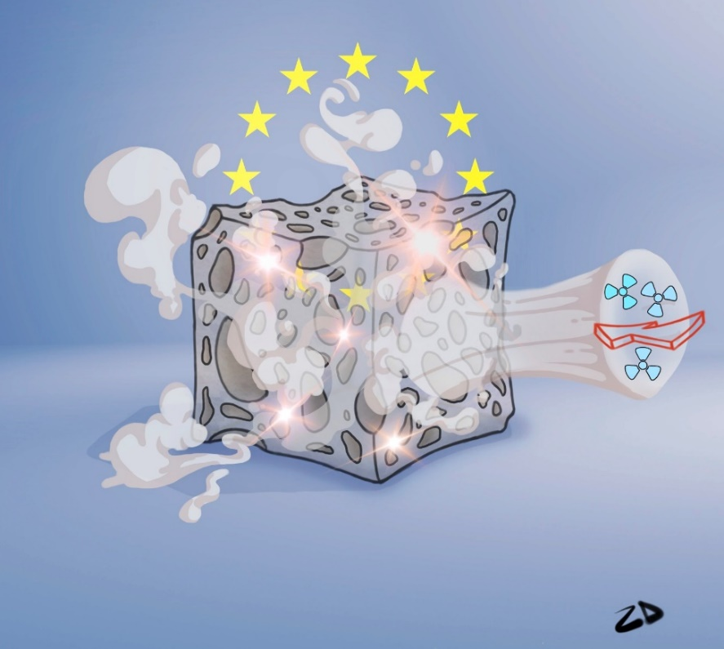
Introduction
Development of new porous scintillators in the framework of SPARTE project
Porous scintillator for radioactive gas detection and metrology:
⁸⁵Kr, ¹³³Xe, ²²²Rn, …
Challenging: ³H, low energy beta emission
Optimization of the morphology acts on the fraction of deposited energy of the primary electron to be detected
➔ What is the response of such scintillators especially at low energy?
We need a metrological method to measure the light yield of the scintillator at ³H energy, Compton-TDCR:
Place a mono-energetic ɣ-ray source below the scintillation sample
Gate on a specific energy in the gamma channel to record the number of detected photons in the PMTs
Repeat for several energies and obtain the curve of the light output as a function of the deposited energy in the scintillator

Slide 3
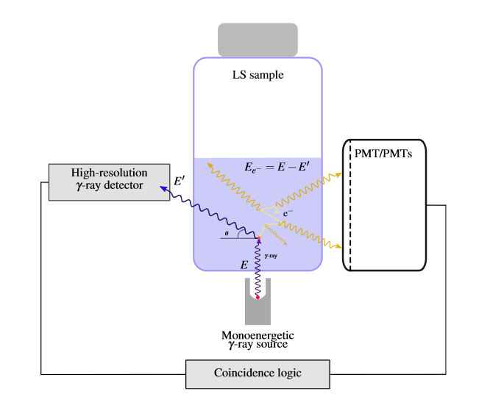
Development of Compton-TDCR
Technical barriers
Long acquisition times caused by:
low flux of external beam from the source (if the ɣ detection efficiency is low, too high activity will cause too much accidental coincidences)
optimal geometry of the ɣ detector and external source
gating on the ɣ using a single channel analyser; can be fixed by a DAQ system
Significant double Compton contribution near 90° geometry:
can be mitigated by allowing the change of the angle between source and detector and considering only events where single scattering is near maximum probability
Accidental coincidences:
may be significant due to the low probability of useful events (>1%)
high scintillation counting rate needed to get reasonable ɣ-scintillation coincidences
Low accuracy on light photon counting:
➔ Can be mitigated with our recent work: TDCR counter for scintillation counting.

Slide 4
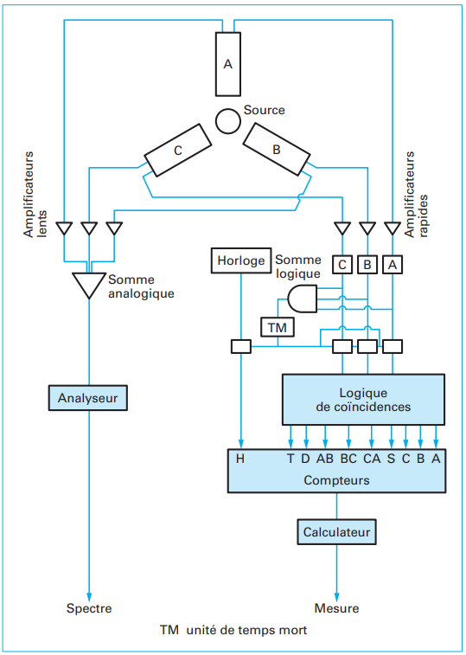
Triple-to-Double Coincidence Ratio (TDCR) in short
Requires a scintillation counter with 3 PMTs each threshold set at single photon detection
Electronics to acquire the average number of triple (T) and double (D) coincidences but also: each individual signal (A, B and C) with a threshold setting, each double coincidence (AB, BC, BC)
Used in radioactivity metrology for standardization of pure beta emitters: considering the normalized spectrum S(E) of the energy emitted by the radionuclide
$$TDCR= \frac{\int_{spectrum}^{ }{S(E){(1−e^{−\frac{ναm(E) }{3}})}^{3}}}{\int_{spectrum}^{ }{S\left(E\right)({3\left(1− e^{−\frac{ναm(E)}{3}}\right)}^{2}−2{\left(1− e^{−\frac{ναm(E)}{3}}\right)}^{3}}} where m (E)=\int_{0}^{E}{\frac{ dE}{1+k_{B} \frac{dE}{dx}}}$$
With α scintillation efficiency (photons·keV⁻¹), k_{B} scintillator parameter (from 0.005 to 0.018 cm·MeV⁻¹), dE/dx the linear energy transfer of ionizing radiation
Considering that for a large number of events: $TDCR= \frac{T}{D}=\frac{ε_{T}}{ε_{D}}$
Very sensitive and precise technique and strong compensation of counting problem with the model
Schematic diagram of the counter
(P. Cassette, Technique de l’ingénieur, P2552 v2)

Slide 5
Instrumental equipment

Slide 6
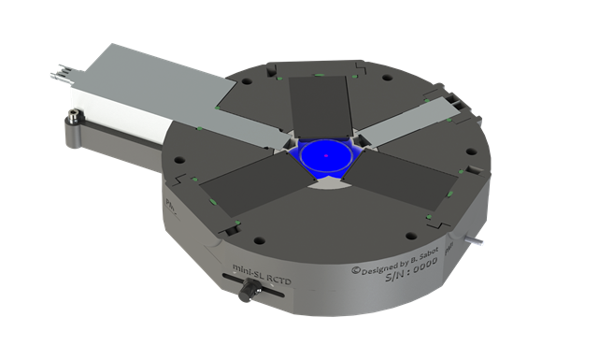
Design of the device
Mini-TDCR^{[1]} with Compton spectrometer
Modified 3D printed portable TDCR device that was developed for on-site calibration
3 PMTs
G
B
Vial with scintillator
Compton spectrometer CdTe with cooler and pre-AMP
A
C
Small thickness of material between the vial and the spectrometer
Ring holder to install a gamma source below
^{[1]}B. Sabot, C. Dutsov, P. Cassette, K. Mitev, Performance of portable TDCR systems developed at LNE-LNHB, Nuclear Instruments and Methods in Physics Research Section A: Accelerators, Spectrometers, Detectors and Associated Equipment, Volume 1034, 2022, 166721, ISSN 0168-9002, https://doi.org/10.1016/j.nima.2022.166721.

Slide 7
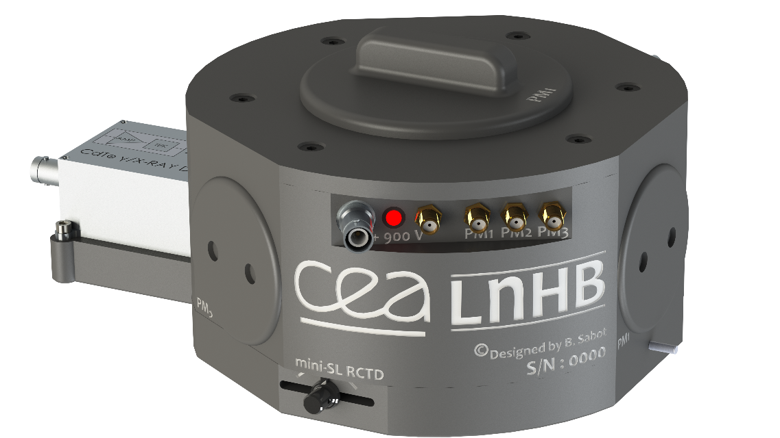
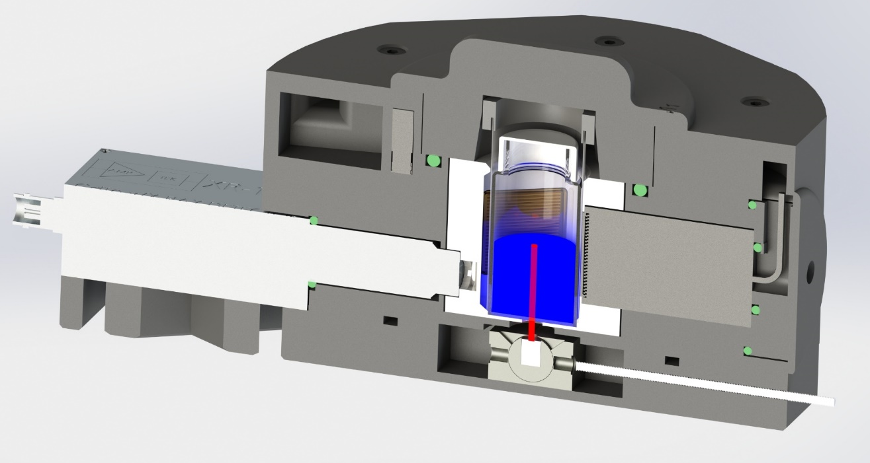
Design of the device
Shielding and moving the source
²⁴¹Am sealed source; Eγ = 59.54 keV, the angle can be changed
Sample: any sample contained in 20 mL liquid scintillation vial can be used or solid cylinder
Beam from the source
CdTe
Rotation with mark for source position
Translation rode
Lead shielding with source rotation and translation

Slide 8
Acquisition and signal processing
CAEN digitizer connected to the 4 channels, software
A dedicated software developed to analyze the CAEN data was updated with the following functions:
Include the fourth (gamma) channel and count the AG, … ABG, BCG, …, DG, ABCG coincidences
Gate on a specified energy range in the A, B, C or G channels
Get the function of the number of A, B,..,G, AG,… ,ABG,… ,DG, ABCG coincidences with respect to the deposited energy in the G channel
With a single measurement we can obtain the coincidence counting rates in the TDCR for all energies detected in the gamma channel for arbitrarily long coincidence resolving time and dead-time base
This considerably shortens the measurement time and allows for the estimation of accidental coincidences in each channel
Module: 2/4 Channel 10 bit 2/1 GS/s Digitizer

Slide 9
Analysis of the results

Slide 10
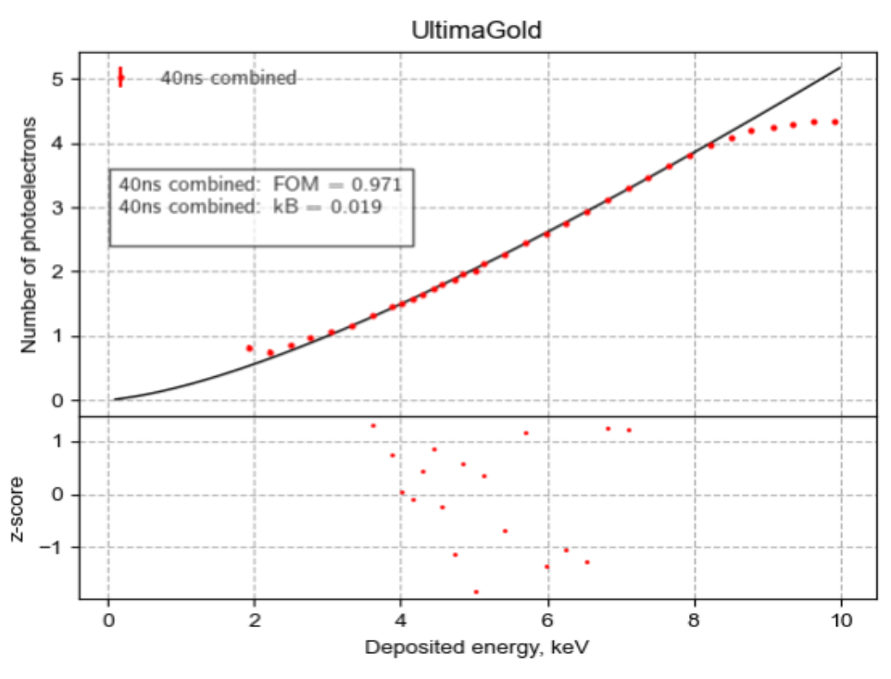
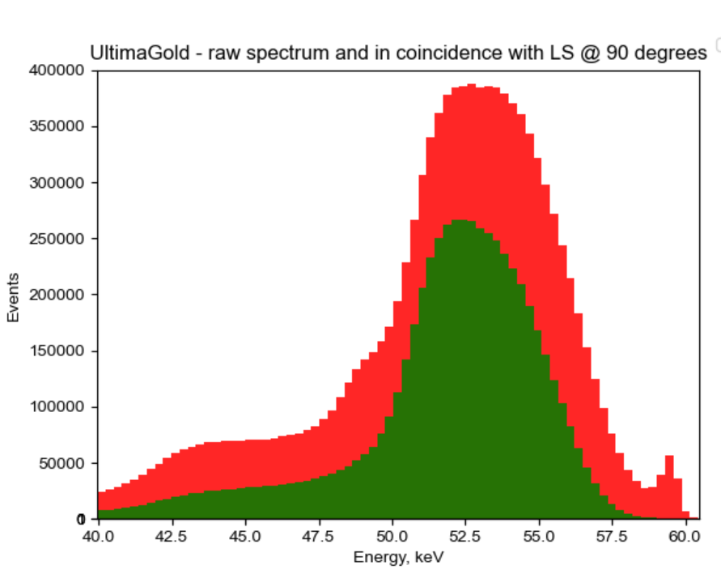
Analysis of the results
Compton-TDCR and data analysis
We analyze the list-mode data to obtain the number of coincidences for each energy bin
➔ On average we obtain around 100 000 TDCR events per energy channel (270 eV channel width) for a 48 h measurement
With the assumption of mono-energetic electrons we can calculate the average number of detected photons
We get the relative light output as a function of the deposited energy:
Repeat for each energy bin and get $N_{avg}(E)$:
Double Compton
Too low number of photon, very low probability of coincidences
$$N_{avg}=−ln\left(1−\frac{T}{AB}\right)$$
$$N_{avg}=−ln\left(1−\frac{T}{AB}\right)−ln\left(1−\frac{T}{BC}\right)−ln\left(1−\frac{T}{AC}\right)$$
Get AB, BC, AC, D, T coïncidences

Slide 11
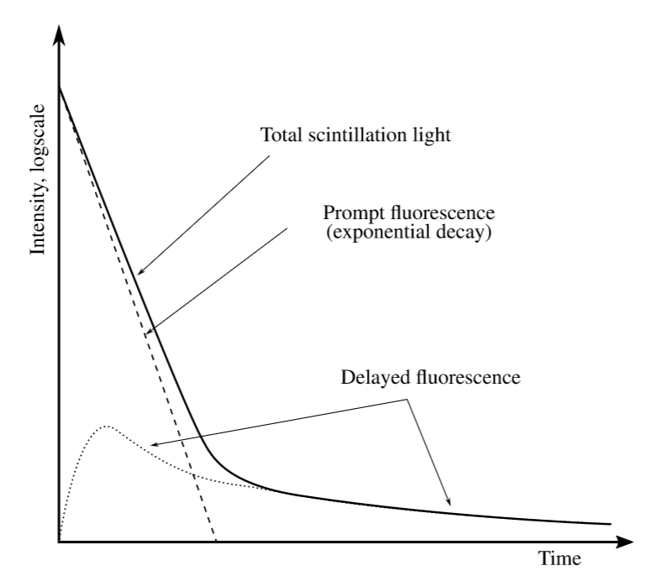
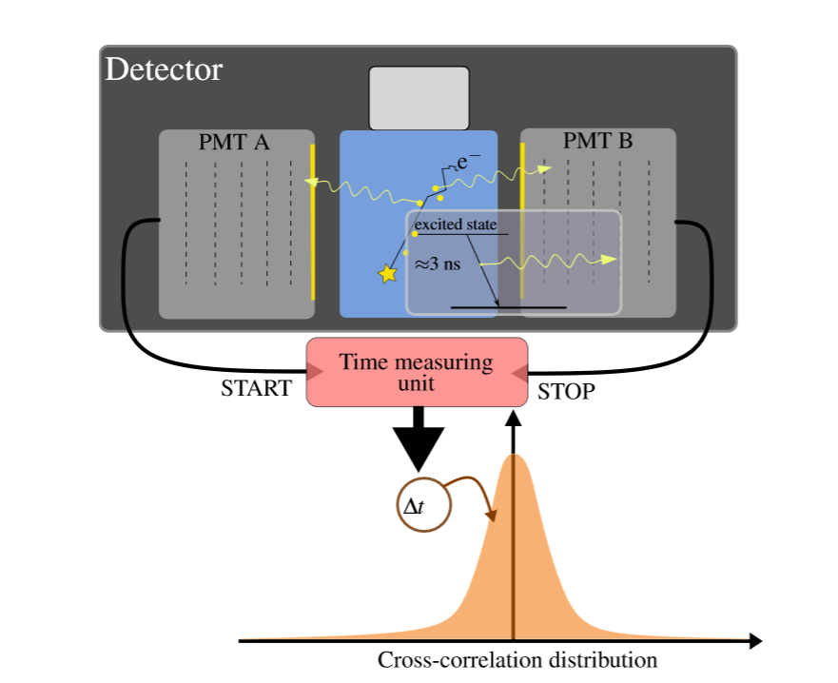
Timing properties measurement
Characterization of the timing properties of scintillator
We can use the same data set measurement to perform this analysis
We use the following equations to get intensity of each compound, λ is the timing properties:
Prompt, Birks
Delayed, King & Voltz

Slide 12
Experimental results

Slide 13
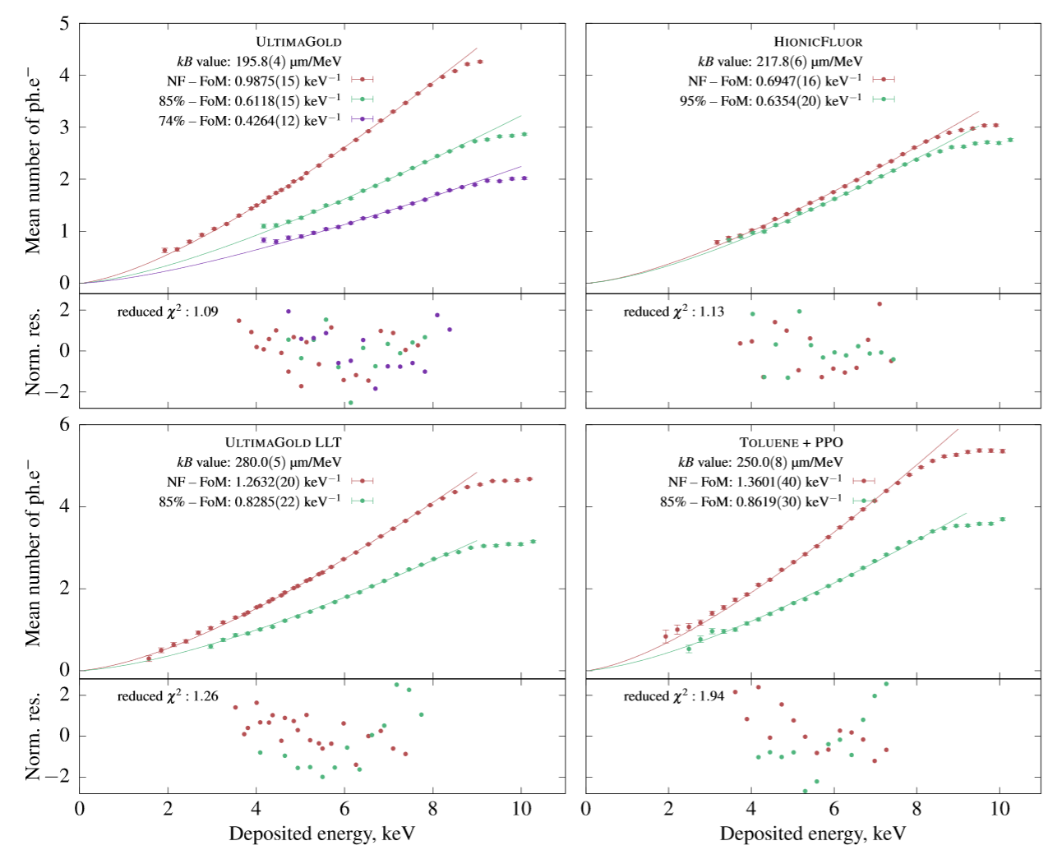
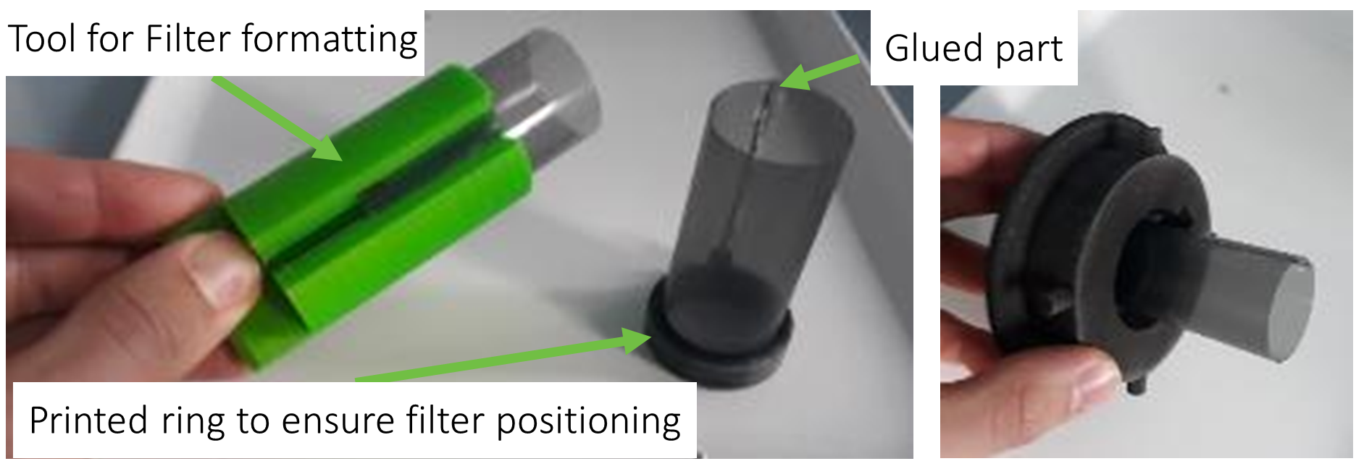
Measured light yield
Example with 4 commercially available liquid scintillators
Variation of the light output with neutral density filters
Printed filter with ink on plastic film
Specific holder to fit the device and the vial

Slide 14
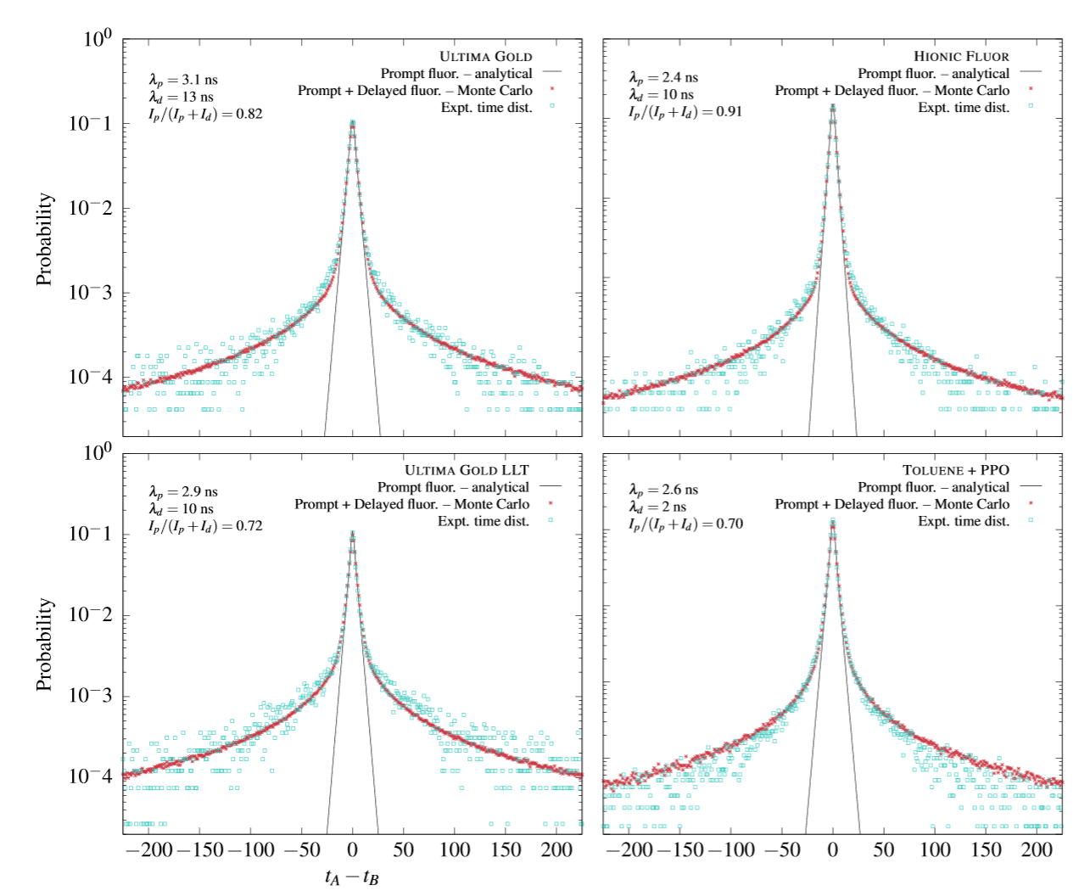
Measurement of timing properties
The same data are processed to measure the time distribution of events between 2 PMTs (here PMT A and B)
Critical result for metrology and TDCR counting: optimum coincidence window for the measurement
In our case, faster is better for metrology (limited by Birks model)

Slide 15
Summary and perspectives

Slide 16
Summary and perspectives
Summary
TDCR device for precise photon counting
Compton-TDCR device developed to measure the light yield of the scintillator
Timing properties measured at the same time
Example of results with commercial scintillators
Perspectives
Measurement of porous scintillator light yield (See Pavlo Mai and Sharvanee Mauree posters)
Use of the response for metrology of radioactive gas and scintillator optimization
Study the response of new scintillators in order to improve metrology of radionuclides (liquid, solid or other) (example with M. Baravaglio presentation), and more for fundamental research on scintillation process
This device will be used in the framework of SPARTE FET OPEN project for the online calibration of radioactive gas with porous scintillator, for more details: https://www.sparte-project.eu/
NOTE : This device allows 3 measurement methods for the calibration of radionuclides

Slide 17
Thank you. Any questions?
benoit.sabot@cea.fr

Slide 18
Monte-Carlo simulation of the device
Use the device to validate a Monte-Carlo model
A Monte-Carlo model of Compton-TDCR counter is built on GEANT4 (PENELOPE MODEL)
GEANT4 can simulate particle transportation in a volume and can generate light photon
We can test the model and compare with the Compton-TDCR results to improve the simulations

Slide 19
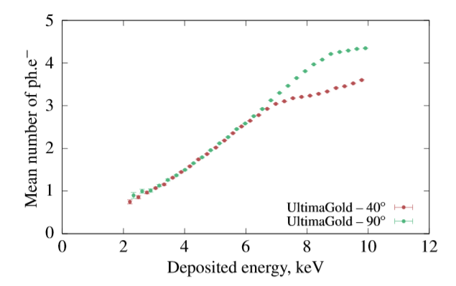
Measured light yield
Comparison with different angles between beam and detector
Same results with different angles, can be used to get more data at lower energy
With this scintillator below 2 keV we have less than one photon and thus it is our limit

Slide 20
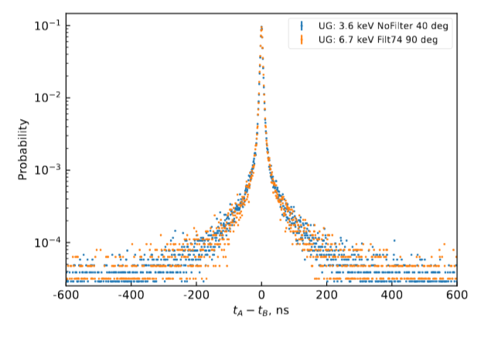
Measurement of timing properties
Variation of the energy and light photon measurement
Same timing with less photons for the same scintillator
The photons reduction is obtained using neutral density filters
➔ This system can be used for various scintillators, as long as the shape of the sample is reasonably large and transparent next experiment will be done with porous YAG(Ce)

Slide 21
Analysis of the results
Comparaison to a model and limitations of the current device
The obtained light output as a function of deposited energy is then fitted with Birks’ ionization quenching function:
The average number of detected photons is then:
λ – Figure of merit (FOM) detected photons per keV released in the cocktail
Double Compton
$$N_{avg}=λEQ\left(E\right)$$
Too low number of photon, very low probability of coincidences

